Slide 1

TalentWatch
Senior Leader Action Planning Meeting
September 2018 Survey Administration

Slide 2
Agenda
TalentWatch Survey Results
Taking Action
Purpose, Process and Outcomes

Slide 3
Purpose and Key Outcomes
Understand Results
React
Surprises?
Affirmations?
Decide Groups, Issues & People
Notes:
UNDERSTAND
Our first purpose is to orient you to the survey metrics, results and trends. This is your first time seeing the data so this call is the perfect opportunity to ask questions. A key outcome is that you walk away from today’s session with clarity on the results and what they mean.
Optional: You have some groups doing really well and some groups that are in jeopardy, which we will discuss. There are also issues across the organization that are critical to your
effectiveness.
REACT
Our next purpose is to get your reactions to the data and your feedback on what may contributing to areas of opportunity. We have already discussed the results with your Executive Team…We will give you insight on their reactions, but a key outcome is for you to begin to think about the areas will have the most impact for your groups.
DECIDE
The final purpose of this call is to orient you to your resources and next steps in the process. The key outcome will be for you to decide the groups, people and issues you need to address to increase the engagement and retention of the teams you manage.

Slide 4
Recommended Targets for Action
Strengthen the Connection between Employees and Senior Management – Empower leaders to communicate the reasoning behind policies and ensure that they are consistently applied. Communicate frequently, respectfully, & build trust by providing the “why” behind decisions made.
Clearly Define Organizational Policies, Practices and Procedures – Define and promote other aspects of your Employee Value Proposition (e.g., schedules, work/life balance, company brand/culture, growth and promotional opportunities)
Prioritize Training and Development – Provide employees with opportunities to grow their skills; talk to employees to determine current gaps in training and development. Provide leadership training to ensure leaders are equipped to hold difficult conversations with employees.
Leverage the Strength of “Direct Supervisor” Relationships – Encourage leaders to have regular one-on-one conversations with employees to address development goals and reinforce organizational policies.

Slide 5

TalentWatch®
Anonymous Engagement Survey
Survey
Metrics
  Measures employees’ levels of engagement
  Results leveraged at every leadership level
  Proven to improve engagement, retention and performance metrics
Overall Measures
Behavior Specific Indices
Intent to Stay
Overall Satisfaction
Satisfaction Change
Employee Net Promoter Score (ENPS)
Leader (LEI)
Organization (OEI)
Job/Career (JEI)
Co-worker (CEI)
Join Factors
Notes:
Mention:
Anonymous survey
Minimum respondent count = 3

Slide 6
TalentWatch Survey Participation
Survey Administration: 9/10/2018 - 9/21/2018
Eligible Participants: 1105
Two Surveys: General 44% & Leader 42%
Group | Completion Percentage | Count
ALVSCE | 44% | 488
Tabashnik | 51% | 26
McDonald | 59% | 30
Davis | 71% | 5
Silvertooth | 48% | 163
Ratje | 86% | 12
Koprowski | 28% | 31
Chorover | 36% | 25
Farrell-Poe | 30% | 9
Group | Completion Percentage | Count
Jenks | 32% | 37
Rahr | 54% | 7
Staten | 78% | 18
Antin | 57% | 4
Stock | 32% | 36
Going | 35% | 24
Husman | 80% | 24
Notes:
Higher than past
70% goal
Concerns with anonymity and what happens with data (cultural hesitation)

Slide 7
Representativeness
Responses are representative of the overall population

Slide 8

Dashboard: Fundamental Metrics
77%
Intent to Leave
Are satisfied at work
More than 10 years: 32% (158)
5 to 10 years: 26% (128)
3 to 5 years: 17% (85)
1 to 3 years: 21% (103)
Less than 1 year: 3% (14)
ENPS: 25
27%
Recommend as a Good Place to Work
Goal: 30 or higher
Moderate: 1 to 29
Focus: 0 or lower
Are more satisfied today, 18% less satisfied than 6 months ago
Top Reasons for
JOINING
Why employees
STAY Themes
Why employees may
LEAVE Themes
Type of work
Learn new skills
Benefits
Organization’s reputation
Job Duties 27%
Benefits 17%
Coworkers 14%
Leadership 13%
Leadership 27%
Pay 24%
Career 13%
Funding 10%
Notes:
Sat: 70% goal; 75% good
Point out counts (this is when they plan to leave; could be managed turnover)
Funding: not underfunded; “if” funding is cut

Slide 9
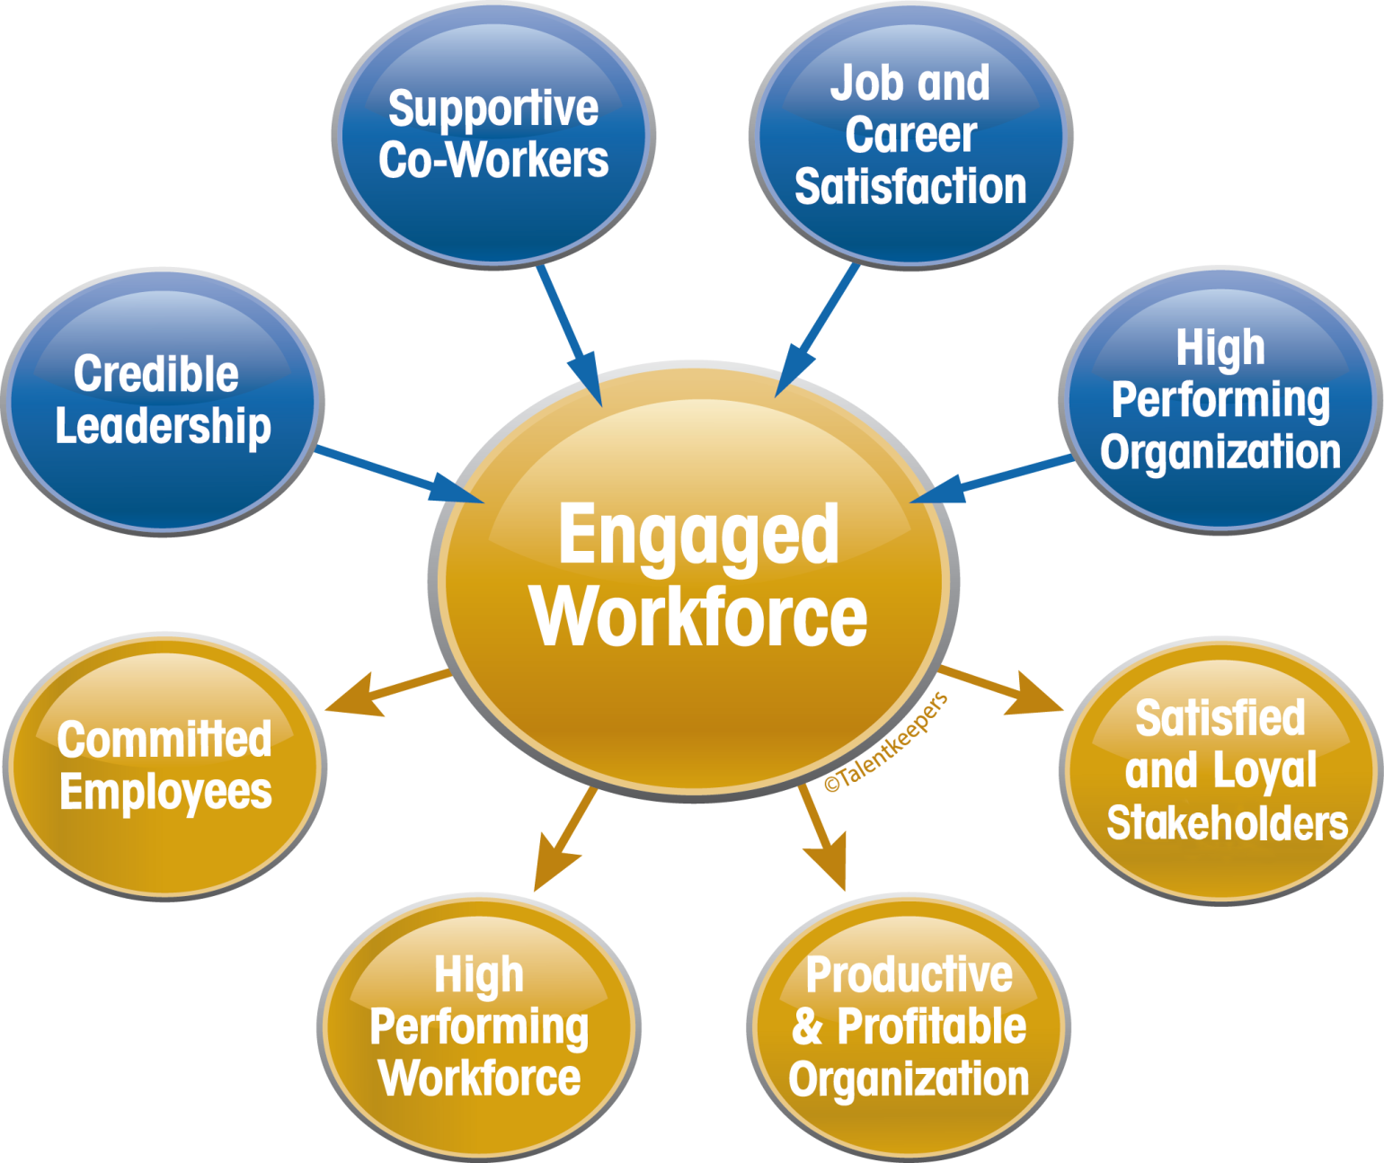
Employee Engagement
Notes:
18 years of research for four factors

Slide 10
Employee Engagement Indices
Dashboard
Index Goal = 80%
OEI Benchmark: 67%
Education Benchmark: 63%
=Engaged
=Disengaged
JEI Benchmark: 70%
Education Benchmark: 67%
CEI Benchmark: 76%
Education Benchmark: 73%
LEI Benchmark: 73%
Education Benchmark: 74%
Education Benchmark based on 21 institutions with ~50% representing Universities
Notes:
Describe what the benchmarks are: It’s not an “aspirational goal”, it’s an average of all orgs
Mention that goal = 80%

Slide 11
Organization Engagement Index
Percent Engaged

Slide 12
Organization Engagement Index
Percent Engaged

Slide 13
Organization Engagement Items | Current | Past
OEI | 64% | --
I am satisfied with the location where I come to work on a daily basis. | 78% | 75%
My organization values diversity and inclusion. | 76% | --
My organization shows respect for employees. | 75% | 62%
I am satisfied with my commute to work. | 75% | --
My organization consistently demonstrates that delivering quality services is a high priority. | 74% | 82%
My organization supports a balance between work and personal life. | 73% | 62%
Senior Management keeps me informed of the goals and direction of our organization. | 69% | --
Senior Management is accessible and approachable when necessary. | 68% | --
The organization's vision/mission/goals inspire me and help me be more productive. | 62% | 71%
I feel that I can question a policy or practice, without fear of being penalized. | 62% | 73%
Senior Management in my organization is open, honest, and transparent in communication. | 61% | 55%
My organization's policies and procedures help create an effective work environment. | 59% | --
My organization's process and procedures to evaluate and promote employees is fair. | 51% | 42%
Notes:
P&P and senior management were also the most disagreed to

Slide 14
Job & Career Engagement Index
Percent Engaged

Slide 15
Job & Career Engagement Index
Percent Engaged

Slide 16
Job & Career Engagement Items | Current | Past
JEI | 78% | --
My job is challenging and interesting. | 89% | 85%
At work, I have the opportunity to utilize my skills and do what I do best. | 87% | --
My decision-making authority is sufficient for me to perform my job effectively. | 85% | --
This is a career that I love and believe in. | 84% | --
I am satisfied with the tasks and responsibilities associated with my job. | 83% | --
I am satisfied with my current work schedule. | 83% | --
I can fit in at work without having to change who I am. | 82% | --
I have the information and resources needed to effectively get my work done. | 81% | 68%*
I fully understand my compensation plan. | 80% | --
At work, I have sufficient opportunities for personal and professional growth. | 69% | 53%
I receive the training needed to perform my job effectively. | 68% | 68%
*Past data score is an average of two similarly phrased questions

Slide 17
Co-Worker Engagement Index
Percent Engaged

Slide 18
Co-Worker Engagement Index
Percent Engaged

Slide 19
Co-Worker Engagement Items | Current | Past
CEI | 76% | --
Most of my co-workers deliver quality work and put forth extra effort to help our organization succeed. | 81% | --
I receive the support I need to be able to succeed from most of my co-workers. | 81% | 79%*
Most of my co-workers demonstrate interest and concern for my personal well being. | 80% | 76%
Most of my co-workers communicate effectively with me. | 80% | --
My co-workers respect employee differences by valuing diversity and inclusion. | 75% | 80%
While working on assigned tasks, most of my co-workers do not just participate; they seem engaged in their tasks. | 74% | --
Most of my co-workers value and support my work and career goals. | 74% | --
*Past data score is an average of two similarly phrased questions

Slide 20
Leader Engagement Index
Percent Engaged
©TalentKeepers®
Notes:
Group data; not individual data

Slide 21
Leader Engagement Index
Percent Engaged
©TalentKeepers®

Slide 22
Leader Engagement Items (Slide 1) | Current | Past
LEI | 73% | --
My leader provides me flexibility and choice in how I do my work. | 88% | --
My leader recognizes my efforts and achievements and wants me to be successful. | 83% | 72%
My leader tells the truth and meets commitments. Does what he/she says he/she will do. | 82% | 72%
My leader is someone I can trust. | 82% | 74%
My leader recognizes and takes into account my work/life balance needs. | 81% | 76%
My leader listens when I have suggestions on how to do things better. | 80% | 72%
My leader is caring and concerned for me as an individual. | 79% | 79%
My leader is interested in having only the best qualified people added to the team. | 79% | --
My leader creates an inclusive environment that values and respects employee differences. | 78% | 78%
My leader believes an engaged and stable workforce is important for organizational success. | 77% | --
My leader clearly communicates expectations and the reasons behind changing priorities. | 77% | --
My leader is concerned with a new team member's fit with the organization's values, goals, and practices, as well as how likely they are to stay with the organization. | 75% | --

Slide 23
Leader Engagement Items (Slide 2) | Current | Past
LEI | 73% | --
My leader helps me feel empowered and creates an environment that encourages decision-making. | 75% | --
My leader supports high goals, keeps me informed of progress, and emphasizes how my work contributes to organizational success. | 74% | --
The feedback my leader provides me helps me improve my performance. | 73% | 64%
My leader makes work challenging and satisfying by encouraging fun and provides as much choice as possible regarding work activities. | 69% | --
My leader holds team members appropriately accountable for performance. | 68% | 59%
My leader increases my desire to come to work and do my best. | 68% | --
My leader is an effective coach and motivator who enables me to achieve the career and professional objectives I have set. | 68% | 57%
My leader adapts his/her communication and coaching style to effectively relate to diverse audiences. | 65% | --
My leader identifies top performers and creates ways to engage and retain them. | 59% | --
My leader is aware of team members who may be thinking of leaving and takes appropriate action to encourage them to stay. | 44% | --

Slide 24
Leader Engagement Index
54% (30) of leaders ≥ 80% 23% (13) of leaders ≤ 50%
Engagement & Team Performance Comparisons
Consistent Results | High Engagement = High Performance Low Engagement = Low Performance
Inconsistent Results | High Engagement = Low Performance Low Engagement = High Performance
Why?
Who?
Notes:
Engagement & Team Performance Comparisons
Consistent Results: High Engagement = High Performance & Low Engagement = Low Performance
The LEI score correlates to job performance, specifically in customer satisfaction areas. And it will usually align with related operational metrics, but there will be exceptions.
Inconsistent Results: High Engagement = Low Performance. Why? Who?
A leader who has a high LEI score, but an under-performing team could indicate that the leader is liked, but doesn’t hold their teams accountable. Perhaps they “blame up” when discussing goals , policies and procedures. This style is not effective. People won’t work to achieve a goal if they feel that their leader doesn’t think it’s important or achievable.
Inconsistent Results: Low Engagement = High Performance. Why? Who?
A leader who has a low LEI score but is getting good operational results may be holding team members accountable for all the right things, but the team doesn’t like it. These leaders may have been asked to move to an under-performing area because they are a strong leader, the resistance from their team should be a temporary situation. If this pattern persists over time it could indicate the leader is not effectively managing the team to high performance levels. If a leader is too hard on their team to deliver better performance, it will be difficult for them to deliver extraordinary service. Leaders should use their survey results to identify areas to improve.

Slide 25
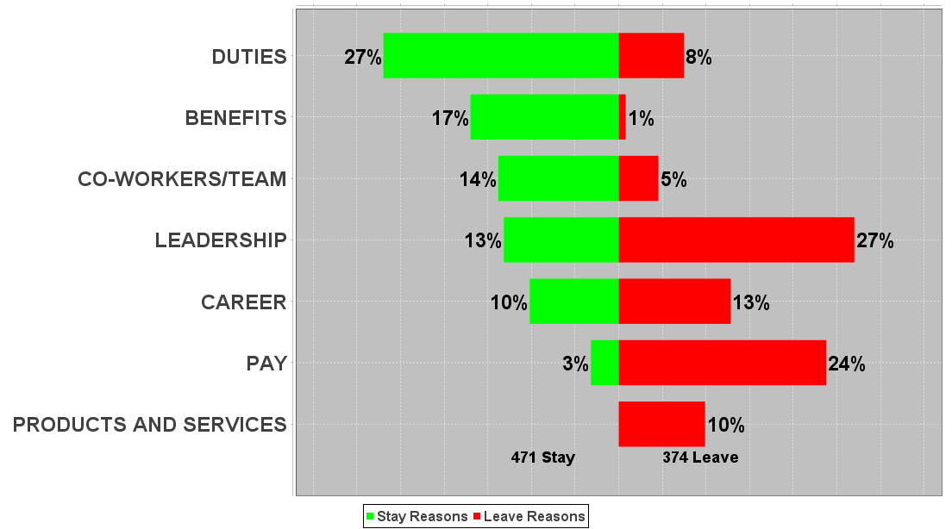
Free Responses: Stay & Leave Themes
xx%
BIC 65%
FUNDING
STAY | Themes
Job Duties | Work is interesting and meaningful; Enjoy working with the community
Benefits | Good benefits package, especially the health insurance and Qualified Tuition Reduction
Coworkers | Supportive coworkers; Sense of camaraderie; Great teamwork
LEAVE | Themes
Leadership | Poor communication; Lack of support from senior leadership; Lack of respect and appreciation from leadership
Pay | Low pay rate; Lack of pay raises; Inequitable pay
Career | No opportunities for advancement
Notes:
Good news, less leave than stay

Slide 26
Employee Net Promoter Score (ENPS)
  Measures employees’ willingness to recommend the organization as a good place to work
  Scale: (negative) -100 to (positive) +100
  ENPS Calculation = (Promoters – Detractors) ÷ Total # of Respondents
Detractors
1-6 Rating
Negative referral & feedback
Rarely recommend
Passively satisfied
Promoters
9-10 Rating
Proud to recommend
Loyalty unstable & short-term
Reduce motivation & pride
Diminished loyalty
Enthusiastic
Loyal
Passives
7-8 Rating
Notes:
Calculated by subtracting Detractors from Promoters, then dividing by the total number of respondents

Slide 27
Willingness to Recommend as a GOOD Place to Work
Goal: 30 or higher; Moderate: 1-30; Focus: 0 or below
How likely are you to recommend the organization as a good place to work? | ENPS (-100 to 100) | Detractor Count | Passive Count | Promoter Count
ALVSCE | 25 | 99 | 168 | 221
Tabashnik | 31 | 6 | 6 | 14
McDonald | -10 | 10 | 13 | 7
Davis | 40 | 0 | 3 | 2
Ratje | 83 | 0 | 2 | 10
Silvertooth | 28 | 34 | 49 | 80
Koprowski | 19 | 7 | 11 | 13
Chorover | 32 | 4 | 9 | 12
Farrell-Poe | 44 | 0 | 5 | 4
Jenks | -22 | 15 | 15 | 7
Rahr | 43 | 0 | 4 | 3
Staten | 33 | 3 | 6 | 9
Antin | 100 | 0 | 0 | 4
Stock | 14 | 9 | 13 | 14
Going | 42 | 3 | 8 | 13
Husman | 33 | 3 | 10 | 11
Notes:
Stringent metric
-100 to +100
221 promoters

Slide 28
ENPS Free Responses Themes
What would increase your willingness to recommend as a good place to work?
Category | Themes
Pay | Increase in salaries; Salaries that were more competitive with the national average
Leadership | Greater transparency from the senior administration; More support and better communication from all levels of leadership but primarily from senior leaders

Slide 29
Recommendations Summary
1. Transparency and Trust
Communicate frequently, respectfully, & build trust by providing the “why” behind decisions made. Prior to sharing organization, empower leaders with talking points in case they need assistance answering questions from their teams When information cannot be shared, explain intentions and the reasons why Ensure that leaders clearly communicate and consistently apply evaluation and promotion processes Recognize employees for work well-done
2. Training and Development
Individual Contributor Training and Development Hold leaders accountable for having periodic career conversations with employees Educate employees on the availability of training and growth opportunities and how to participate Gain insight from employees regarding gaps in training and development (via focus groups) Leadership Training and Development Train leaders on best practices in performance management (e.g., setting clear goals, providing regular feedback, addressing performance issues promptly) Train leaders to be honest about performance and manage differently based on level

Slide 30
What Are Your Leaders
Being Asked To Do?
Get them
ENGAGED!
1) Review report
5) Manage differently based on results and feedback - ONGOING
4) Develop action plan and submit online
2) Meet with Leader
3) Meet with Team to review results
Ask “Start, Stop & Continue” questions

Slide 31
Next Steps for Senior Leaders
DECIDE
IMPLEMENT
Groups, Issues, People you will address
ACTION PLAN
How to address focus areas with success goals within your group and as an individual leader
Behavior modification with review and accountability for goal progress
COMMUNICATE
Send Senior Leader memo, thanking employees for participation and highlighting strengths and areas to address
Dashboard
Coaching Guide

Slide 32
Appendix

Slide 33
Organization Engagement Items Slide 1 | ALVSCE | Tabashnik | McDonald | Davis | Silvertooth | Ratje
OEI | 64% | 69% | 33% | 100% | 70% | 92%
I am satisfied with the location where I come to work on a daily basis. | 78% | 81% | 97% | 80% | 77% | 83%
My organization values diversity and inclusion. | 76% | 81% | 53% | 80% | 82% | 100%
My organization shows respect for employees. | 75% | 81% | 57% | 100% | 77% | 100%
I am satisfied with my commute to work. | 75% | 69% | 77% | 40% | 77% | 67%
My organization consistently demonstrates that delivering quality services is a high priority. | 74% | 65% | 53% | 100% | 78% | 100%
My organization supports a balance between work and personal life. | 73% | 77% | 77% | 100% | 77% | 92%
Senior Management keeps me informed of the goals and direction of our organization. | 69% | 65% | 43% | 100% | 72% | 100%
Senior Management is accessible and approachable when necessary. | 68% | 65% | 37% | 80% | 68% | 100%
The organization's vision/mission/goals inspire me and help me be more productive. | 62% | 46% | 37% | 100% | 69% | 100%
I feel that I can question a policy or practice, without fear of being penalized. | 62% | 69% | 40% | 40% | 64% | 75%
Senior Management in my organization is open, honest, and transparent in communication. | 61% | 62% | 27% | 100% | 64% | 92%
My organization's policies and procedures help create an effective work environment. | 59% | 62% | 33% | 60% | 56% | 92%
My organization's process and procedures to evaluate and promote employees is fair. | 51% | 65% | 33% | 40% | 52% | 67%

Slide 34
Organization Engagement Items Slide 2 | ALVSCE | Koprowski | Chorover | Farrell-Poe | Jenks | Rahr
OEI | 64% | 65% | 76% | 78% | 30% | 86%
I am satisfied with the location where I come to work on a daily basis. | 78% | 77% | 72% | 56% | 78% | 100%
My organization values diversity and inclusion. | 76% | 84% | 88% | 67% | 57% | 86%
My organization shows respect for employees. | 75% | 77% | 84% | 89% | 46% | 86%
I am satisfied with my commute to work. | 75% | 71% | 76% | 89% | 68% | 100%
My organization consistently demonstrates that delivering quality services is a high priority. | 74% | 71% | 76% | 89% | 59% | 86%
My organization supports a balance between work and personal life. | 73% | 58% | 80% | 67% | 46% | 100%
Senior Management keeps me informed of the goals and direction of our organization. | 69% | 74% | 64% | 78% | 46% | 100%
Senior Management is accessible and approachable when necessary. | 68% | 68% | 88% | 89% | 41% | 86%
The organization's vision/mission/goals inspire me and help me be more productive. | 62% | 52% | 64% | 56% | 62% | 71%
I feel that I can question a policy or practice, without fear of being penalized. | 62% | 68% | 72% | 56% | 35% | 86%
Senior Management in my organization is open, honest, and transparent in communication. | 61% | 68% | 76% | 67% | 35% | 71%
My organization's policies and procedures help create an effective work environment. | 59% | 65% | 72% | 67% | 43% | 86%
My organization's process and procedures to evaluate and promote employees is fair. | 51% | 58% | 60% | 67% | 24% | 43%

Slide 35
Organization Engagement Items Slide 3 | ALVSCE | Staten | Antin | Stock | Going | Husman
OEI | 64% | 72% | 100% | 58% | 63% | 75%
I am satisfied with the location where I come to work on a daily basis. | 78% | 89% | 100% | 69% | 46% | 92%
My organization values diversity and inclusion. | 76% | 83% | 100% | 75% | 50% | 58%
My organization shows respect for employees. | 75% | 78% | 100% | 67% | 92% | 88%
I am satisfied with my commute to work. | 75% | 78% | 75% | 78% | 62% | 88%
My organization consistently demonstrates that delivering quality services is a high priority. | 74% | 83% | 100% | 64% | 75% | 88%
My organization supports a balance between work and personal life. | 73% | 83% | 100% | 72% | 71% | 83%
Senior Management keeps me informed of the goals and direction of our organization. | 69% | 89% | 100% | 58% | 67% | 79%
Senior Management is accessible and approachable when necessary. | 68% | 61% | 100% | 67% | 79% | 83%
The organization's vision/mission/goals inspire me and help me be more productive. | 62% | 67% | 100% | 44% | 62% | 71%
I feel that I can question a policy or practice, without fear of being penalized. | 62% | 67% | 50% | 64% | 71% | 67%
Senior Management in my organization is open, honest, and transparent in communication. | 61% | 67% | 100% | 53% | 75% | 67%
My organization's policies and procedures help create an effective work environment. | 59% | 67% | 100% | 50% | 67% | 75%
My organization's process and procedures to evaluate and promote employees is fair. | 51% | 67% | 75% | 47% | 33% | 50%

Slide 36
Job & Career Engagement Items Slide 1 | ALVSCE | Tabashnik | McDonald | Davis | Silvertooth | Ratje
JEI | 78% | 96% | 77% | 100% | 75% | 92%
My job is challenging and interesting. | 89% | 100% | 90% | 100% | 87% | 75%
At work, I have the opportunity to utilize my skills and do what I do best. | 87% | 81% | 80% | 100% | 85% | 92%
My decision-making authority is sufficient for me to perform my job effectively. | 85% | 85% | 83% | 100% | 85% | 92%
This is a career that I love and believe in. | 84% | 96% | 93% | 100% | 82% | 83%
I am satisfied with the tasks and responsibilities associated with my job. | 83% | 88% | 87% | 100% | 85% | 92%
I am satisfied with my current work schedule. | 83% | 92% | 87% | 80% | 85% | 92%
I can fit in at work without having to change who I am. | 82% | 96% | 67% | 80% | 82% | 83%
I have the information and resources needed to effectively get my work done. | 81% | 88% | 77% | 100% | 80% | 100%
I fully understand my compensation plan. | 80% | 85% | 90% | 60% | 79% | 100%
At work, I have sufficient opportunities for personal and professional growth. | 69% | 85% | 67% | 100% | 66% | 100%
I receive the training needed to perform my job effectively. | 68% | 69% | 60% | 80% | 68% | 83%

Slide 37
Job & Career Engagement Items Slide 2 | ALVSCE | Koprowski | Chorover | Farrell-Poe | Jenks | Rahr
JEI | 78% | 81% | 92% | 67% | 68% | 100%
My job is challenging and interesting. | 89% | 90% | 92% | 78% | 89% | 100%
At work, I have the opportunity to utilize my skills and do what I do best. | 87% | 90% | 96% | 78% | 92% | 100%
My decision-making authority is sufficient for me to perform my job effectively. | 85% | 81% | 88% | 78% | 86% | 100%
This is a career that I love and believe in. | 84% | 90% | 84% | 67% | 81% | 57%
I am satisfied with the tasks and responsibilities associated with my job. | 83% | 74% | 96% | 78% | 84% | 86%
I am satisfied with my current work schedule. | 83% | 81% | 84% | 67% | 65% | 100%
I can fit in at work without having to change who I am. | 82% | 74% | 92% | 78% | 73% | 100%
I have the information and resources needed to effectively get my work done. | 81% | 81% | 92% | 67% | 59% | 100%
I fully understand my compensation plan. | 80% | 84% | 88% | 89% | 54% | 100%
At work, I have sufficient opportunities for personal and professional growth. | 69% | 68% | 84% | 78% | 43% | 71%
I receive the training needed to perform my job effectively. | 68% | 68% | 80% | 67% | 62% | 71%

Slide 38
Job & Career Engagement Items Slide 3 | ALVSCE | Staten | Antin | Stock | Going | Husman
JEI | 78% | 72% | 100% | 67% | 75% | 88%
My job is challenging and interesting. | 89% | 89% | 100% | 92% | 79% | 92%
At work, I have the opportunity to utilize my skills and do what I do best. | 87% | 94% | 100% | 72% | 83% | 96%
My decision-making authority is sufficient for me to perform my job effectively. | 85% | 100% | 100% | 78% | 83% | 88%
This is a career that I love and believe in. | 84% | 67% | 100% | 83% | 75% | 88%
I am satisfied with the tasks and responsibilities associated with my job. | 83% | 61% | 100% | 67% | 75% | 92%
I am satisfied with my current work schedule. | 83% | 72% | 100% | 81% | 75% | 92%
I can fit in at work without having to change who I am. | 82% | 78% | 100% | 86% | 88% | 92%
I have the information and resources needed to effectively get my work done. | 81% | 83% | 100% | 69% | 88% | 96%
I fully understand my compensation plan. | 80% | 83% | 50% | 72% | 83% | 96%
At work, I have sufficient opportunities for personal and professional growth. | 69% | 67% | 100% | 58% | 79% | 58%
I receive the training needed to perform my job effectively. | 68% | 50% | 100% | 67% | 75% | 67%

Slide 39
Co-Worker Engagement Items Slide 1 | ALVSCE | Tabashnik | McDonald | Davis | Silvertooth | Ratje
CEI | 76% | 85% | 57% | 100% | 78% | 100%
Most of my co-workers deliver quality work and put forth extra effort to help our organization succeed. | 81% | 85% | 70% | 100% | 83% | 100%
I receive the support I need to be able to succeed from most of my co-workers. | 81% | 85% | 73% | 100% | 83% | 100%
Most of my co-workers demonstrate interest and concern for my personal well being. | 80% | 85% | 77% | 100% | 85% | 100%
Most of my co-workers communicate effectively with me. | 80% | 81% | 73% | 100% | 79% | 100%
My co-workers respect employee differences by valuing diversity and inclusion. | 75% | 88% | 60% | 80% | 76% | 92%
While working on assigned tasks, most of my co-workers do not just participate; they seem engaged in their tasks. | 74% | 81% | 67% | 80% | 75% | 92%
Most of my co-workers value and support my work and career goals. | 74% | 81% | 63% | 100% | 74% | 83%

Slide 40
Co-Worker Engagement Items Slide 2 | ALVSCE | Koprowski | Chorover | Farrell-Poe | Jenks | Rahr
CEI | 76% | 65% | 84% | 67% | 65% | 100%
Most of my co-workers deliver quality work and put forth extra effort to help our organization succeed. | 81% | 68% | 88% | 67% | 81% | 100%
I receive the support I need to be able to succeed from most of my co-workers. | 81% | 61% | 84% | 89% | 70% | 100%
Most of my co-workers demonstrate interest and concern for my personal well being. | 80% | 68% | 76% | 67% | 70% | 71%
Most of my co-workers communicate effectively with me. | 80% | 74% | 92% | 89% | 76% | 100%
My co-workers respect employee differences by valuing diversity and inclusion. | 75% | 74% | 88% | 67% | 57% | 86%
While working on assigned tasks, most of my co-workers do not just participate; they seem engaged in their tasks. | 74% | 58% | 84% | 67% | 54% | 100%
Most of my co-workers value and support my work and career goals. | 74% | 68% | 96% | 89% | 62% | 57%

Slide 41
Co-Worker Engagement Items Slide 3 | ALVSCE | Staten | Antin | Stock | Going | Husman
CEI | 76% | 89% | 100% | 72% | 83% | 67%
Most of my co-workers deliver quality work and put forth extra effort to help our organization succeed. | 81% | 94% | 75% | 69% | 88% | 71%
I receive the support I need to be able to succeed from most of my co-workers. | 81% | 89% | 100% | 72% | 88% | 83%
Most of my co-workers demonstrate interest and concern for my personal well being. | 80% | 89% | 75% | 75% | 83% | 71%
Most of my co-workers communicate effectively with me. | 80% | 83% | 100% | 67% | 83% | 88%
My co-workers respect employee differences by valuing diversity and inclusion. | 75% | 83% | 100% | 72% | 79% | 58%
While working on assigned tasks, most of my co-workers do not just participate; they seem engaged in their tasks. | 74% | 83% | 100% | 72% | 79% | 75%
Most of my co-workers value and support my work and career goals. | 74% | 83% | 100% | 67% | 79% | 62%

Slide 42
Leader Engagement Items Slide 1 | ALVSCE | Tabashnik | McDonald | Davis | Silvertooth | Ratje
LEI | 73% | 100% | 61% | 80% | 70% | 100%
My leader provides me flexibility and choice in how I do my work. | 88% | 96% | 86% | 60% | 89% | 92%
My leader recognizes my efforts and achievements and wants me to be successful. | 83% | 100% | 71% | 100% | 80% | 100%
My leader tells the truth and meets commitments. Does what he/she says he/she will do. | 82% | 100% | 75% | 100% | 78% | 100%
My leader is someone I can trust. | 82% | 100% | 79% | 100% | 76% | 100%
My leader recognizes and takes into account my work/life balance needs. | 81% | 92% | 86% | 100% | 78% | 92%
My leader listens when I have suggestions on how to do things better. | 80% | 100% | 82% | 60% | 75% | 100%
My leader is caring and concerned for me as an individual. | 79% | 96% | 75% | 100% | 73% | 100%
My leader is interested in having only the best qualified people added to the team. | 79% | 100% | 68% | 100% | 79% | 92%
My leader creates an inclusive environment that values and respects employee differences. | 78% | 96% | 68% | 100% | 75% | 100%
My leader believes an engaged and stable workforce is important for organizational success. | 77% | 100% | 75% | 100% | 73% | 100%
My leader clearly communicates expectations and the reasons behind changing priorities. | 77% | 100% | 71% | 100% | 71% | 83%

Slide 43
Leader Engagement Items Slide 2 | ALVSCE | Tabashnik | McDonald | Davis | Silvertooth | Ratje
LEI | 73% | 100% | 61% | 80% | 70% | 100%
My leader is concerned with a new team member's fit with the organization's values, goals, and practices, as well as how likely they are to stay with the organization. | 75% | 92% | 50% | 100% | 73% | 83%
My leader helps me feel empowered and creates an environment that encourages decision-making. | 75% | 92% | 61% | 40% | 74% | 92%
My leader supports high goals, keeps me informed of progress, and emphasizes how my work contributes to organizational success. | 74% | 96% | 57% | 100% | 68% | 92%
The feedback my leader provides me helps me improve my performance. | 73% | 100% | 64% | 80% | 71% | 92%
My leader makes work challenging and satisfying by encouraging fun and provides as much choice as possible regarding work activities. | 69% | 92% | 57% | 100% | 65% | 75%
My leader holds team members appropriately accountable for performance. | 68% | 92% | 61% | 100% | 64% | 92%
My leader increases my desire to come to work and do my best. | 68% | 84% | 61% | 80% | 63% | 83%
My leader is an effective coach and motivator who enables me to achieve the career and professional objectives I have set. | 68% | 88% | 61% | 80% | 63% | 83%
My leader adapts his/her communication and coaching style to effectively relate to diverse audiences. | 65% | 76% | 64% | 20% | 61% | 92%
My leader identifies top performers and creates ways to engage and retain them. | 59% | 80% | 50% | 60% | 53% | 92%
My leader is aware of team members who may be thinking of leaving and takes appropriate action to encourage them to stay. | 44% | 68% | 32% | 40% | 40% | 50%

Slide 44
Leader Engagement Items Slide 3 | ALVSCE | Koprowski | Chorover | Farrell-Poe | Jenks | Rahr
LEI | 73% | 85% | 83% | 88% | 58% | 100%
My leader provides me flexibility and choice in how I do my work. | 88% | 93% | 96% | 88% | 61% | 100%
My leader recognizes my efforts and achievements and wants me to be successful. | 83% | 89% | 96% | 100% | 71% | 100%
My leader tells the truth and meets commitments. Does what he/she says he/she will do. | 82% | 89% | 96% | 100% | 65% | 100%
My leader is someone I can trust. | 82% | 89% | 96% | 100% | 65% | 100%
My leader recognizes and takes into account my work/life balance needs. | 81% | 81% | 88% | 88% | 55% | 100%
My leader listens when I have suggestions on how to do things better. | 80% | 89% | 100% | 100% | 61% | 100%
My leader is caring and concerned for me as an individual. | 79% | 89% | 92% | 100% | 61% | 71%
My leader is interested in having only the best qualified people added to the team. | 79% | 78% | 88% | 75% | 68% | 100%
My leader creates an inclusive environment that values and respects employee differences. | 78% | 85% | 92% | 100% | 55% | 86%
My leader believes an engaged and stable workforce is important for organizational success. | 77% | 81% | 88% | 88% | 58% | 86%
My leader clearly communicates expectations and the reasons behind changing priorities. | 77% | 85% | 96% | 88% | 65% | 100%

Slide 45
Leader Engagement Items Slide 4 | ALVSCE | Koprowski | Chorover | Farrell-Poe | Jenks | Rahr
LEI | 73% | 85% | 83% | 88% | 58% | 100%
My leader is concerned with a new team member's fit with the organization's values, goals, and practices, as well as how likely they are to stay with the organization. | 75% | 85% | 96% | 75% | 55% | 100%
My leader helps me feel empowered and creates an environment that encourages decision-making. | 75% | 81% | 88% | 88% | 58% | 100%
My leader supports high goals, keeps me informed of progress, and emphasizes how my work contributes to organizational success. | 74% | 85% | 88% | 88% | 65% | 86%
The feedback my leader provides me helps me improve my performance. | 73% | 85% | 83% | 100% | 65% | 57%
My leader makes work challenging and satisfying by encouraging fun and provides as much choice as possible regarding work activities. | 69% | 81% | 67% | 100% | 58% | 100%
My leader holds team members appropriately accountable for performance. | 68% | 78% | 79% | 75% | 58% | 71%
My leader increases my desire to come to work and do my best. | 68% | 81% | 67% | 88% | 58% | 86%
My leader is an effective coach and motivator who enables me to achieve the career and professional objectives I have set. | 68% | 78% | 75% | 88% | 61% | 71%
My leader adapts his/her communication and coaching style to effectively relate to diverse audiences. | 65% | 63% | 79% | 75% | 52% | 71%
My leader identifies top performers and creates ways to engage and retain them. | 59% | 59% | 79% | 62% | 48% | 57%
My leader is aware of team members who may be thinking of leaving and takes appropriate action to encourage them to stay. | 44% | 56% | 54% | 50% | 35% | 57%

Slide 46
Leader Engagement Items Slide 5 | ALVSCE | Staten | Antin | Stock | Going | Husman
LEI | 73% | 75% | 100% | 69% | 77% | 61%
My leader provides me flexibility and choice in how I do my work. | 88% | 94% | 100% | 89% | 91% | 87%
My leader recognizes my efforts and achievements and wants me to be successful. | 83% | 75% | 100% | 81% | 82% | 83%
My leader tells the truth and meets commitments. Does what he/she says he/she will do. | 82% | 75% | 100% | 81% | 100% | 74%
My leader is someone I can trust. | 82% | 88% | 100% | 78% | 100% | 83%
My leader recognizes and takes into account my work/life balance needs. | 81% | 88% | 100% | 86% | 77% | 87%
My leader listens when I have suggestions on how to do things better. | 80% | 94% | 100% | 78% | 91% | 74%
My leader is caring and concerned for me as an individual. | 79% | 88% | 100% | 81% | 82% | 78%
My leader is interested in having only the best qualified people added to the team. | 79% | 81% | 100% | 69% | 86% | 61%
My leader creates an inclusive environment that values and respects employee differences. | 78% | 88% | 100% | 75% | 91% | 65%
My leader believes an engaged and stable workforce is important for organizational success. | 77% | 94% | 75% | 67% | 82% | 78%
My leader clearly communicates expectations and the reasons behind changing priorities. | 77% | 75% | 100% | 72% | 73% | 78%

Slide 47
Leader Engagement Items Slide 6 | ALVSCE | Staten | Antin | Stock | Going | Husman
LEI | 73% | 75% | 100% | 69% | 77% | 61%
My leader is concerned with a new team member's fit with the organization's values, goals, and practices, as well as how likely they are to stay with the organization. | 75% | 94% | 100% | 78% | 82% | 65%
My leader helps me feel empowered and creates an environment that encourages decision-making. | 75% | 81% | 100% | 75% | 91% | 65%
My leader supports high goals, keeps me informed of progress, and emphasizes how my work contributes to organizational success. | 74% | 75% | 100% | 61% | 77% | 74%
The feedback my leader provides me helps me improve my performance. | 73% | 75% | 100% | 75% | 59% | 70%
My leader makes work challenging and satisfying by encouraging fun and provides as much choice as possible regarding work activities. | 69% | 75% | 100% | 67% | 86% | 57%
My leader holds team members appropriately accountable for performance. | 68% | 62% | 100% | 67% | 59% | 61%
My leader increases my desire to come to work and do my best. | 68% | 75% | 100% | 69% | 68% | 70%
My leader is an effective coach and motivator who enables me to achieve the career and professional objectives I have set. | 68% | 69% | 100% | 69% | 59% | 65%
My leader adapts his/her communication and coaching style to effectively relate to diverse audiences. | 65% | 81% | 100% | 64% | 59% | 65%
My leader identifies top performers and creates ways to engage and retain them. | 59% | 62% | 100% | 58% | 77% | 52%
My leader is aware of team members who may be thinking of leaving and takes appropriate action to encourage them to stay. | 44% | 44% | 75% | 44% | 55% | 48%

Slide 48
AREA
Scores in Red are below the organization’s score
Attribute | Organization Engagement | Job & Career Engagement | Co-Worker Engagement | Leader Engagement | Overall Favorable Satisfaction | Intent to Stay (High) | Employee Net Promoter Score (ENPS)
In Tucson Area (313) | 64% | 80% | 77% | 76% | 78% | 33% | 26
Outside Tucson Area (175) | 65% | 75% | 75% | 69% | 75% | 31% | 23

Slide 49
UA TOTAL FTE
Scores in Red are below the organization’s score
Attribute | Organization Engagement | Job & Career Engagement | Co-Worker Engagement | Leader Engagement | Overall Favorable Satisfaction | Intent to Stay (High) | Employee Net Promoter Score (ENPS)
0.5 (25) | 80% | 88% | 72% | 84% | 84% | 28% | 48
0.6 (5) | 80% | 100% | 100% | 100% | 100% | 60% | 80
0.7 (3) | 67% | 67% | 100% | 100% | 67% | 33% | 0
0.75 (28) | 75% | 71% | 89% | 81% | 86% | 32% | 43
0.8 (6) | 67% | 100% | 100% | 100% | 83% | 50% | 67
0.875 (3) | 100% | 100% | 100% | 33% | 100% | 0% | 67
1 (406) | 62% | 77% | 74% | 71% | 75% | 32% | 21

Slide 50
ALVSCE JOB FTE
Scores in Red are below the organization’s score
Attribute | Organization Engagement | Job & Career Engagement | Co-Worker Engagement | Leader Engagement | Overall Favorable Satisfaction | Intent to Stay (High) | Employee Net Promoter Score (ENPS)
0.5 (25) | 80% | 88% | 72% | 84% | 84% | 28% | 48
0.6 (5) | 80% | 100% | 100% | 100% | 100% | 60% | 80
0.7 (3) | 67% | 67% | 100% | 100% | 67% | 33% | 0
0.75 (29) | 72% | 69% | 86% | 79% | 83% | 31% | 38
0.8 (6) | 67% | 100% | 100% | 100% | 83% | 50% | 67
0.875 (3) | 100% | 100% | 100% | 33% | 100% | 0% | 67
1 (407) | 62% | 77% | 74% | 71% | 75% | 32% | 21

Slide 51
SALARY RANGE
Scores in Red are below the organization’s score
Attribute | Organization Engagement | Job & Career Engagement | Co-Worker Engagement | Leader Engagement | Overall Favorable Satisfaction | Intent to Stay (High) | Employee Net Promoter Score (ENPS)
Less than $30,000 (41) | 68% | 78% | 78% | 76% | 80% | 44% | 34
$30,000 to $60,000 (262) | 68% | 78% | 79% | 73% | 81% | 30% | 34
$60,000 to $100,000 (130) | 62% | 79% | 71% | 74% | 69% | 32% | 12
$100,000 to $150,000 (36) | 50% | 75% | 75% | 79% | 69% | 39% | -8
$150,000 to $200,000 (11) | 36% | 64% | 64% | 44% | 82% | 9% | 9
$200,000 or more (8) | 50% | 100% | 100% | 43% | 88% | 50% | 50

Slide 52
GENERATION
Scores in Red are below the organization’s score
Attribute | Organization Engagement | Job & Career Engagement | Co-Worker Engagement | Leader Engagement | Overall Favorable Satisfaction | Intent to Stay (High) | Employee Net Promoter Score (ENPS)
Silent Generation (3) | 100% | 100% | 100% | 100% | 100% | 0% | 67
Baby Boomers (182) | 57% | 73% | 74% | 68% | 76% | 20% | 17
Generation X (169) | 69% | 80% | 75% | 79% | 77% | 51% | 32
Generation Y (133) | 68% | 83% | 80% | 72% | 78% | 26% | 27

Slide 53
ETHNICITY
Scores in Red are below the organization’s score
Attribute | Organization Engagement | Job & Career Engagement | Co-Worker Engagement | Leader Engagement | Overall Favorable Satisfaction | Intent to Stay (High) | Employee Net Promoter Score (ENPS)
2 or More Races (9) | 89% | 89% | 89% | 100% | 67% | 44% | 33
Asian (12) | 83% | 83% | 67% | 80% | 75% | 33% | 17
Blk African Am (9) | 100% | 100% | 100% | 100% | 100% | 33% | 89
Hispanic Latino (89) | 64% | 80% | 83% | 70% | 81% | 39% | 30
Native American/ Alaskan Native (8) | 62% | 75% | 75% | 43% | 88% | 38% | 12
Non-Resident Alien (14) | 93% | 86% | 93% | 86% | 86% | 14% | 71
Unknown (28) | 39% | 64% | 64% | 58% | 46% | 39% | -7
White Caucasian (317) | 62% | 77% | 74% | 74% | 78% | 30% | 22

Slide 54
GENDER
Scores in Red are below the organization’s score
Attribute | Organization Engagement | Job & Career Engagement | Co-Worker Engagement | Leader Engagement | Overall Favorable Satisfaction | Intent to Stay (High) | Employee Net Promoter Score (ENPS)
Female (316) | 67% | 79% | 78% | 74% | 80% | 34% | 31
Male (172) | 58% | 76% | 74% | 72% | 72% | 30% | 14

Slide 55
LENGTH OF SERVICE
Scores in Red are below the organization’s score
Attribute | Organization Engagement | Job & Career Engagement | Co-Worker Engagement | Leader Engagement | Overall Favorable Satisfaction | Intent to Stay (High) | Employee Net Promoter Score (ENPS)
Less than 3 years (137) | 78% | 79% | 86% | 80% | 86% | 34% | 39
3 to 5 years (73) | 68% | 85% | 78% | 76% | 73% | 32% | 32
5 to 15 years (148) | 59% | 76% | 68% | 70% | 69% | 36% | 14
15 to 25 years (81) | 57% | 79% | 75% | 65% | 79% | 33% | 28
More than 25 years (49) | 47% | 69% | 71% | 73% | 80% | 18% | 2

Slide 56
TENURE
Scores in Red are below the organization’s score
Attribute | Organization Engagement | Job & Career Engagement | Co-Worker Engagement | Leader Engagement | Overall Favorable Satisfaction | Intent to Stay (High) | Employee Net Promoter Score (ENPS)
- (253) | 66% | 76% | 77% | 71% | 80% | 33% | 29
C (29) | 55% | 76% | 66% | 68% | 76% | 34% | -3
CE (12) | 50% | 50% | 67% | 58% | 50% | 33% | -42
CT (20) | 65% | 80% | 60% | 70% | 65% | 25% | 5
FY (72) | 74% | 86% | 82% | 82% | 78% | 28% | 43
NT (3) | 67% | 100% | 100% | 67% | 100% | 33% | 67
T (43) | 30% | 63% | 74% | 57% | 60% | 28% | -14
TE (13) | 69% | 92% | 69% | 91% | 85% | 69% | 23
YY (43) | 77% | 93% | 84% | 90% | 86% | 30% | 53

Slide 57
ABOR Code
Scores in Red are below the organization’s score
Attribute | Organization Engagement | Job & Career Engagement | Co-Worker Engagement | Leader Engagement | Overall Favorable Satisfaction | Intent to Stay (High) | Employee Net Promoter Score (ENPS)
ACP (31) | 74% | 90% | 81% | 90% | 84% | 39% | 45
ADM (20) | 50% | 80% | 85% | 47% | 90% | 35% | 20
CLS (257) | 66% | 76% | 77% | 71% | 80% | 33% | 29
DOC (10) | 100% | 100% | 90% | 100% | 90% | 10% | 90
FAC (102) | 49% | 71% | 67% | 70% | 64% | 33% | -9
SRP (68) | 74% | 87% | 81% | 82% | 76% | 28% | 44

Slide 58
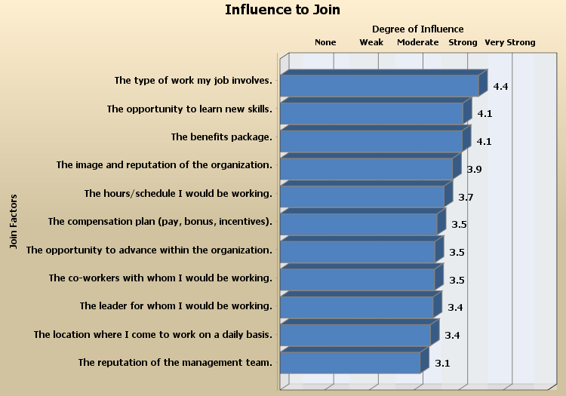
Join Factors
Leverage key factors that influence the decision to join your organization

Slide 59
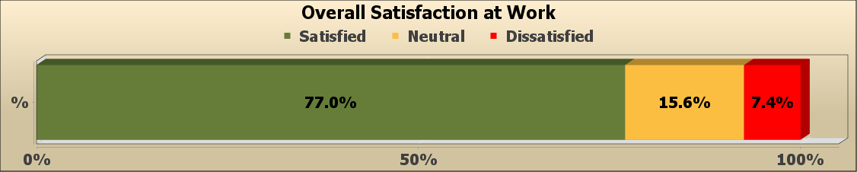
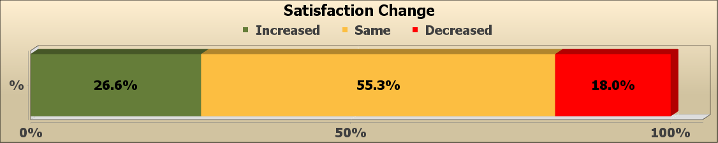
Satisfaction at Work

Slide 60
Intended Length of Stay
117 employees within high or very high risk leave categories
 | Very Low Risk More than 10 years | Low Risk 5 to 10 years | Moderate Risk 3 to 5 years | High Risk 1 to 3 years | Very High Risk Less than 1 year
ALVSCE | 32% (158) | 26% (128) | 17% (85) | 21% (103) | 3% (14)
Tabashnik | 38% (10) | 35% (9) | 8% (2) | 19% (5) | 0% (0)
McDonald | 23% (7) | 43% (13) | 13% (4) | 17% (5) | 3% (1)
Davis | 60% (3) | 40% (2) | 0% (0) | 0% (0) | 0% (0)
Silvertooth | 35% (57) | 22% (36) | 18% (29) | 21% (34) | 4% (7)
Ratje | 33% (4) | 25% (3) | 17% (2) | 25% (3) | 0% (0)
Koprowski | 10% (3) | 35% (11) | 16% (5) | 35% (11) | 3% (1)
Chorover | 32% (8) | 16% (4) | 20% (5) | 28% (7) | 4% (1)
Farrell-Poe | 33% (3) | 11% (1) | 44% (4) | 11% (1) | 0% (0)
Jenks | 16% (6) | 16% (6) | 30% (11) | 35% (13) | 3% (1)
Rahr | 29% (2) | 43% (3) | 29% (2) | 0% (0) | 0% (0)
Staten | 11% (2) | 22% (4) | 28% (5) | 39% (7) | 0% (0)
Antin | 75% (3) | 25% (1) | 0% (0) | 0% (0) | 0% (0)
Stock | 47% (17) | 22% (8) | 14% (5) | 17% (6) | 0% (0)
Going | 42% (10) | 25% (6) | 17% (4) | 12% (3) | 4% (1)
Husman | 54% (13) | 25% (6) | 8% (2) | 12% (3) | 0% (0)

Slide 61
Engagement Index Measures
Engagement Indices
Index Measurement
Organization (OEI)
Job/Career (JEI)
Co-Worker/Team (CEI)
Leader (LEI)
Each index is a composite of specific items
Employees rated items on a 5-point scale (1=strongly disagree; 5=strongly agree)
Employee deemed engaged if average rating of index items is 3.65 or above
Index represents the % of employees engaged
Index score can range from 0% to 100%

