Slide 1
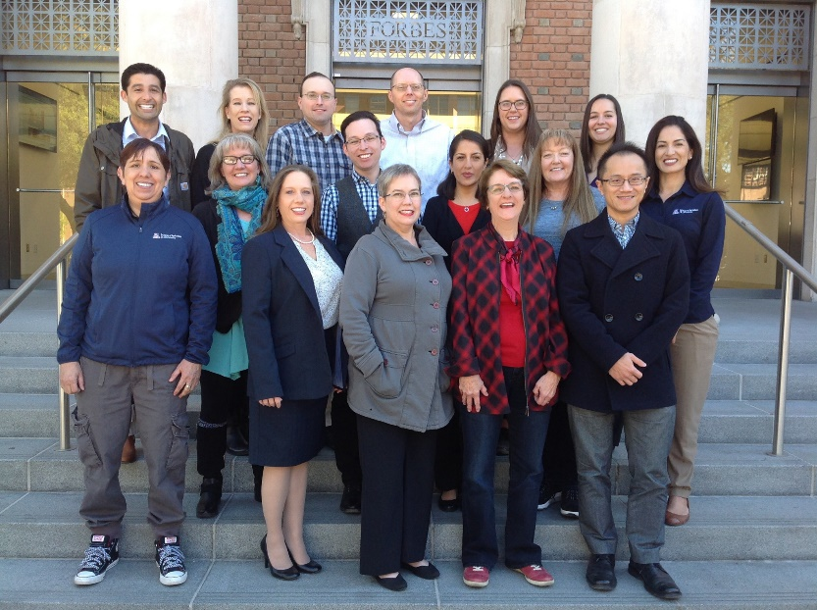
Jeffrey Ratje and his Team ALVSCE Division Business Services
How ALVSCE Leaders support
Diversity and Inclusiveness
This year I/we in Business Services will promote diversity and inclusiveness by:
Ask ourselves “did we think about diversity and inclusion” prior to making decisions;
Recognize that diversity and inclusion are more than what is seen on the outside, and celebrating the diversity of our psychometric, socio-economic, military service, proficiency in languages, physical abilities, personality, etc.;
Speak out in support of diversity and inclusion and champion the cause in our division;
Advocate to enhance the diversity & inclusion statement included in all job posting by UA HR;
Encourage the proactive advertisement of jobs with applicable diversity groups like women and ethnic organizations, veteran’s groups, etc.;
Lead the development of search committee training on mitigating unconscious bias;
Recognize diversity awareness months – celebrating our diversity;

Slide 2
Jeffrey Ratje and his Team ALVSCE Division Business Services
How ALVSCE Leaders support
Diversity and Inclusiveness
Support the ALVSCE Planning, Consulting, and Data Solutions Team in partnership with the Chair of the ALVSCE Diversity & Inclusiveness Council in the creation of diversity dashboards and share this information;
Publicize and encourage participation among the business officers and leaders of ALVSCE at conferences such as WACUBO’s Women in Business Forum, SafeZone Training and Ally Training, and diversity workshops organized by the Office of Diversity and Inclusion and the ALVSCE Diversity & Inclusiveness Council;
Provide time each month at the division business officer meetings for an inclusion moment to discuss implicit bias and foster greater respect of differences; and
Hold others accountable for creating a safe environment that recognizes and nurtures our diversity.

