Slide 1
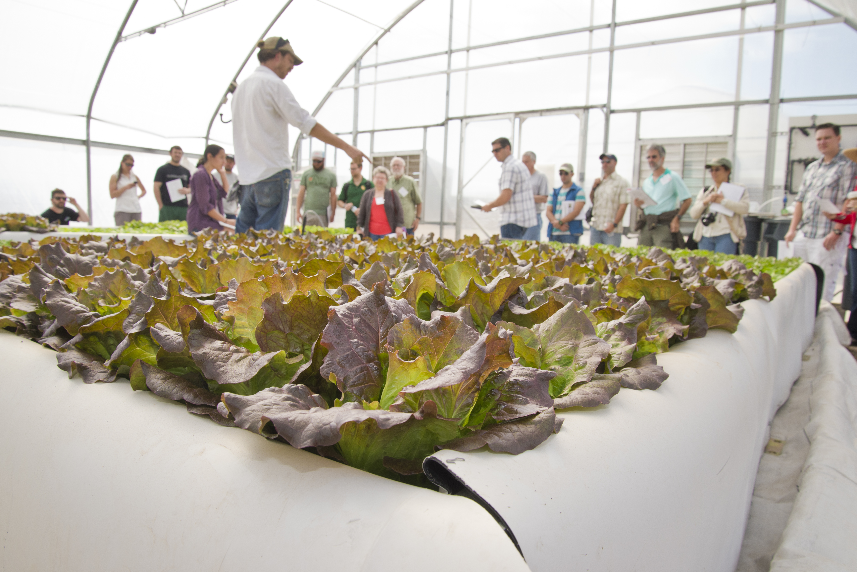
Best Practices for Building Engagement and Culture across the Division
Agriculture, Life and Veterinary Sciences and Cooperative Extension
February 2019

Slide 2
Process
Following is a summary of conversations and best practices gathered from unit leaders within the division. The list is not ordered in terms of priority.
Unit leaders are encouraged to learn from one another. Please implement what works and share your examples with one another.

Slide 3
1. Talk about it
Talking about the culture you want brings it to the forefront. Communicate that each of us is responsible for shaping the culture as much as those in formal leadership roles.
Your colleagues said they:
  Discuss aspirational culture goals on a regular basis in unit/faculty meetings
  Ask what’s working and what can be improved
  Ask for solutions to issues, not just that it isn't working – see best practice #6
  Communicate issues actively and consistently
  Match information to the appropriate audience, don't just email blast all
  Promote trust through transparency, accountability, and communication
Example: Nutritional Sciences host a “Rant and Rave” session once a quarter in unit meetings

Slide 4
2. Be Visible and Accessible
Open door policies show people that you care about them and are interested in what is going on
Your colleagues said they:
  “Let [the folks in my unit] see me”
  Have an open door policy (50% of the leaders interviewed said they had this)
Example: As a result of his 5 year review, Dean Burgess schedules regular walkabouts throughout our organization and tweets about them

Slide 5
3. Socialize
It doesn’t always have to be about work: Taking the team out for lunch or setting up informal get-together builds camaraderie
Your colleagues said they:
  Faculty buy breakfast for staff on Administrative Professionals Day. It's not just about the faculty. Staff deserve connection to the unit too.
  Took their Research faculty out for a 4 hour happy hour (after work of course)
  Host socials 2x a month on an informal basis
  Host 1-2 holiday activities per year
  Eat lunch with faculty (taking 2-3 out at a time): "How's your research going?" "How can I support you better?"
  Host a Friday lunch at the start of the semester
  Have events/potlucks for noteworthy occasions (baby showers, retirements, etc.)
  Host retreats (like Kartchner Caverns) and an annual fall picnic BBQ at Reid Park
Example: Plant Sciences hosts an all-school holiday party in Forbes lobby each year

Slide 6
4. Encourage Innovation
Reward smart risk taking, even when the outcomes are not successful
Your colleagues said they:
  Encourage entrepreneurial behavior (e.g. Mediterranean Diet in Italy) by encouraging risk taking and exploration and making funding available
  Challenge everyone to partner across silos; talk about projects and ventures during group meetings or coaching/mentoring sessions
  Invite staff in vision and mission activities alongside faculty
Example: ACBS initiated the MS in Animal Biomedical Industry; enrollments were lower than expected, but this is an example of a unit taking a smart risk based on student demand. Kudos to ACBS!

Slide 7
5. Make it Welcoming for All
“Diversity is being invited to the dance; Inclusion is being asked to dance.” – Jesus Trevino, former Vice Provost for Inclusive Excellence and Senior Diversity Officer
Your colleagues said they:
  Have an International Student Webpage
  Listen to and respect all opinions; take time to thank people for their contributions – it will make them more willing to share in the future; nip disrespectful commentary in the bud
  Have candid conversations about diversity led by knowledgeable colleagues
  Expect professional courtesy and intervene when it isn't given: "we may not always agree, but we have to support one another and not undermine each other“
    Read about an example of a lack of courtesy given to Chinese students at Duke University
    CALS Communication Values
    ALVSCE Statement on Collegiality
Example: SNRE hosted a panel (composed of diversity council members and diversity leaders at UA) discussion about diversity with faculty, staff, and students in field-intensive science disciplines

Slide 8
6. Listen to, and more importantly, ADDRESS concerns
Addressing concerns (even the little ones) fosters trust and demonstrates reliability
Your colleagues said they:
  Create ad hoc committees to address thematic issues and take tangible action in those areas
  Deal with problems immediately and openly (with the exception of personnel issues) by communicating back to the group/stakeholders what was done about the problem
  Take feedback seriously; don’t dismiss things that you don’t personally think is a problem, and work to address it
  Actively seek out and listen to what’s going on; sometimes a lack of negative feedback is not a good thing, but rather indicates a lack of trust that things will be acted upon or that they won’t be retaliated against – share vulnerability as a leader (e.g. “I’m not sure how to fix this, what are your ideas?”)
  Example: Dean sent out a letter about all factors that affect compensation based on feedback from a meeting regarding the 2018 Employee Engagement Survey

Slide 9
7. Onboard Effectively
Starting a new job is exciting and terrifying; to reduce uncertainty and ensure people feel welcome to their new team and excited about their new role, check in with them periodically, assign them a buddy or mentor, take them out for lunch or have a celebration
Your colleagues said they:
  Personally take new folks around the worksite
  Ensure supervisors discuss their expectations on performance within the first month of employment
  Check in 3-6 months after hire to see how things are going and what questions, suggestions, or concerns new hires have
  Reinforce the mission/purpose: “what matters to us is taking care of students”
Example: Introduce them to the mission and structure of the division through the onboarding video

Slide 10
8. Mentor & Provide Professional Development
Having someone to go to, especially when you’re new, helps new hires navigate
Getting better at something is inherently engaging, people have a drive to master new skills or improve
Your colleagues said they:
  Match new hires with an experienced person (or people)
  Connect new Extension faculty with a mentor outside the county, but within Extension, that they can talk to on a regular basis
  Connect all faculty with mentors: put the onus on the mentor to initiate the check-ins (new people may feel like a burden on mentors and may not initiate); give structure to mentors on how to be effective; choose your best team players and people with traits you want your new folks to emulate to be mentors; ensure mentors get the proper recognition and prestige for filling this important role
  Give them clear targets of what it takes to achieve tenure/continuing status
  Provide recommendations about professional development opportunities to others, encourage their attendance, and financially support them
  Provide $2,500 to all faculty to use however they deem appropriate: classroom use/professional development/research

Slide 11
9. Provide Recognition/Feedback
Recognition and feedback are vital for all employees’ engagement. Recognizing folks in the way that they prefer (public/private/handwritten note/letter from Dean) is motivational.
Your colleagues said they:
  Take the time to think about what award each employee deserves and coordinates nominations
  Acknowledge the good things
  Make sure folks know how much they’re appreciated by giving heartfelt, spontaneous thanks for their contributions
  Gather peer feedback, regardless of whether they’re faculty or staff, and deliver it to the individual in a supportive way
Example: Write a handwritten note giving specific thanks for a recent accomplishment/behavior

Slide 12
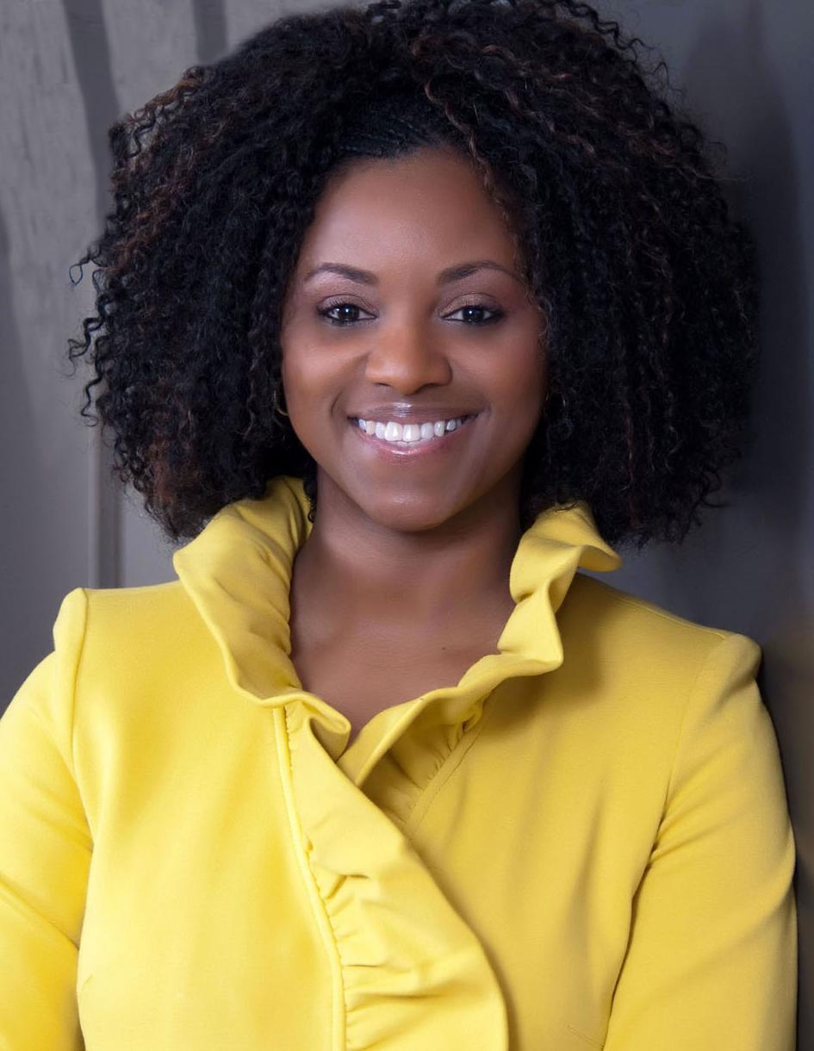
If you do not develop your culture it will develop itself.
Culture doesn’t happen by accident and if it does, you’re taking a risk.
Monique Winston
CEO Optima Lender Services

Slide 13
Further Reading/Resources
Resources
  UA Leads Series (all employees): https://olod.arizona.edu/ua-leads
  Leadership Development Series (managers and supervisors): https://olod.arizona.edu/supervisors
  Future Leaders Workshops: https://diversity.arizona.edu/future-leaders-workshops
  CALS Diversity and Inclusiveness Council events: https://cals.arizona.edu/about/cals-d&i/events
  Set up Leadership and Executive Coaching meetings: UA HR Leadership and Executive Coaching
  Management in Action Program (MAP): http://management.arizona.edu/about-map
  Academic Leadership Institute (ALI): http://ali.arizona.edu/
Books
  Drive – Dan Pink: see this video for a short summary (run time 10:47)
  Radical Candor – Kim Scott: see this video for a short summary (run time 21:20)
  Work Rules! – Laszlo Bock
  The Five Dysfunctions of a Team – Patrick Lencioni
  The Culture Code – Daniel Coyle
  Turn the Ship Around! – L. David Marquet
  Creativity, Inc. – Ed Catmull

