Slide 1
CALS Performance Feedback Workshop
Marisela Celaya & Dustin Green
Human Resources Organizational Consultants

Slide 2
Agenda
Introductions
Tips for Effective Feedback
Worthwhile One-on-Ones
Career Conversations

Slide 3

Introductions
Name
Department
Number employees you supervise
Meaningful feedback

Slide 4
What is “feedback”?

Slide 5

Why is giving feedback difficult?

Slide 6
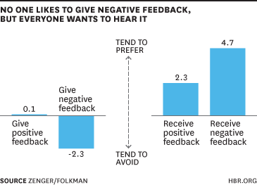
Is it harder to give or to receive feedback?

Slide 7

Meaningful?
When is feedback meaningful?

Slide 8
Without feedback there can be no transformative change.
When we don’t talk to the people we’re leading about their strengths and their opportunities for growth, they begin to question their contributions and our commitment.
Disengagement follows.
~Brene Brown, Daring Greatly

Slide 9
Top 10 Tips

Slide 10

1. Make it timely.

Slide 11

2. Cool down first.

Slide 12

3. Propose an agenda.

Slide 13

4. Find a private space.

Slide 14

5. Be direct.

Slide 15

6. Focus on behavior.

Slide 16

7. Ask questions. Listen to all sides.

Slide 17

8. Don’t try to win.

Slide 18

9. Discuss positive steps forward.

Slide 19

10. Recap the conversation.

Slide 20

Which one is hardest for you?

Slide 21
Situation: Provide employee with feedback regarding not listening to and interrupting team members during weekly team meeting.
Role-Play

Slide 22

Group praise = group impact.

Slide 23
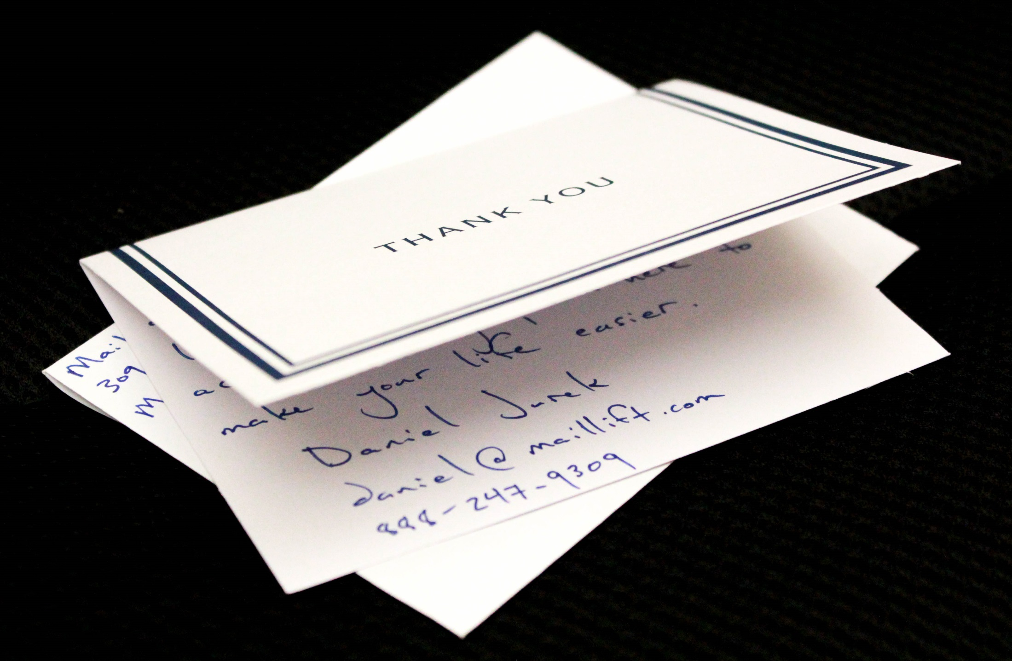
Think outside the (in)box.

Slide 24

Which tip seems the most useful?

Slide 25

BREAK

Slide 26
Worthwhile One-on-Ones

Slide 27
1:1s Myths
“They are project updates”
“I talk to my people all the time”
“We have weekly meetings”
“I’m really close with my staff; they frequently email me updates.”
“If they need anything, they come to me…I have an open door policy.”
“They are too time consuming”

Slide 28

What is the difference between Feedback and Coaching?

Slide 29
PACT Model
Project Updates
Coaching (Feedback Loop)
Timelines
Ask Questions

Slide 30
Project Updates
Employee brings a complete list of projects they are working on. Highlight the ones that are most important or urgent to review.
Which projects are taking up the majority of time?
What progress have I made?
What decisions need happen?

Slide 31
Ask Questions
Employee brings questions to ask the supervisor.
How can I overcome barriers to moving work forward?
What suggestions does my supervisor have help me improve my performance?

Slide 32
Coaching (Feedback Loop)
Supervisor shares important information coming from leadership and asks for input.
Supervisor provides coaching to the employee and gives appropriate praise/recognition.
Employee shares feedback on how the supervisor can improve.

Slide 33
Timelines
Agree on immediate next steps.
Who is accountable for these?
When will these be complete?
How will we follow up?

Slide 34
Kahoot!

Slide 35
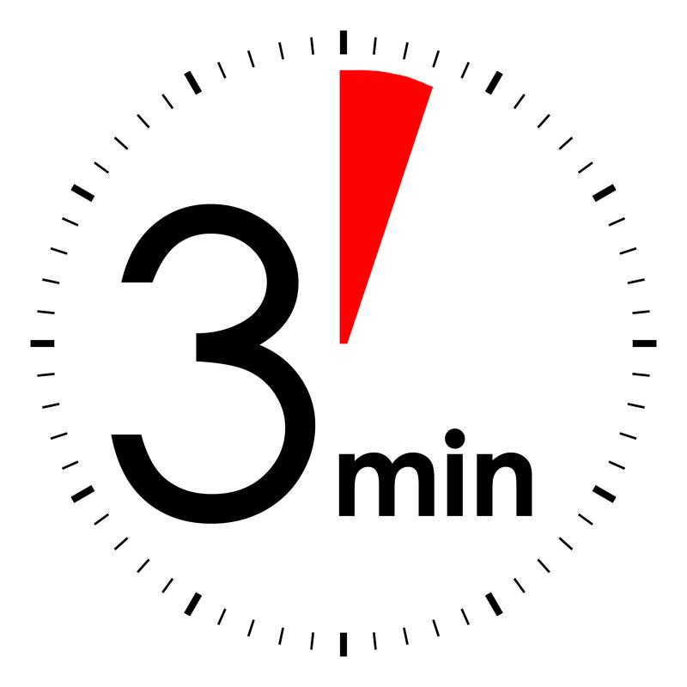

Slide 36
Career Conversations

Slide 37
Career Conversations Overview
What are Career Conversations?
Why is the University moving to this approach?
Why are there no ratings?
Why are Career Conversations beneficial?
What is the value of honest, direct and regular feedback?
Is a Career Conversation required?

Slide 38
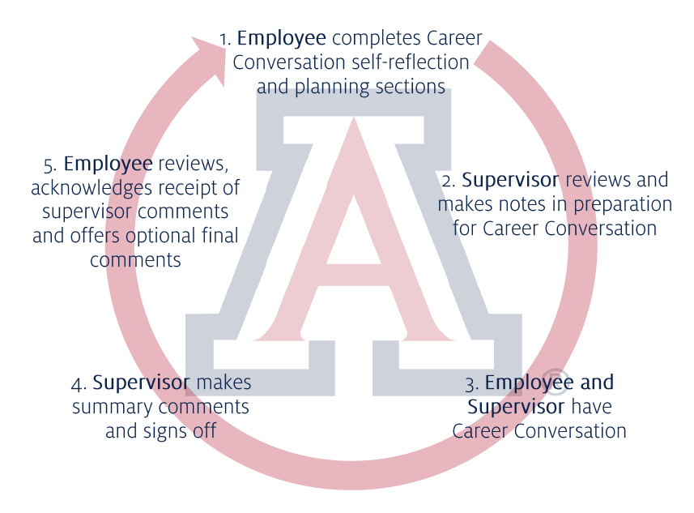
Career Conversations Process Model

Slide 39
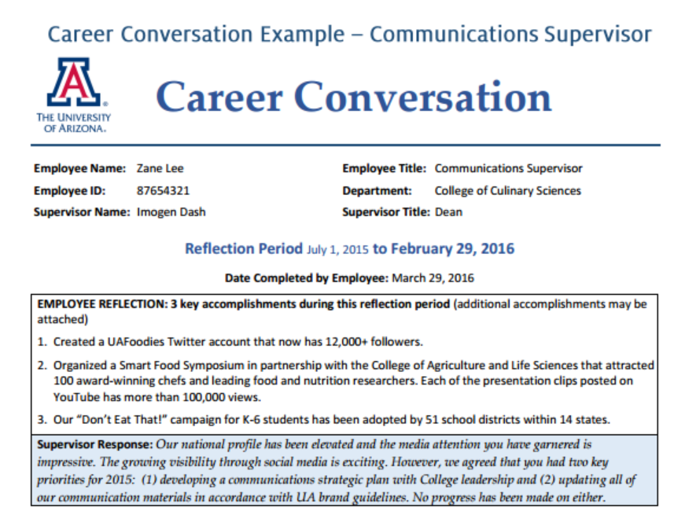

Slide 40
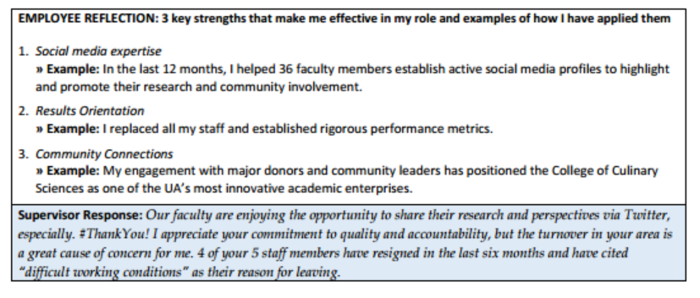

Slide 41
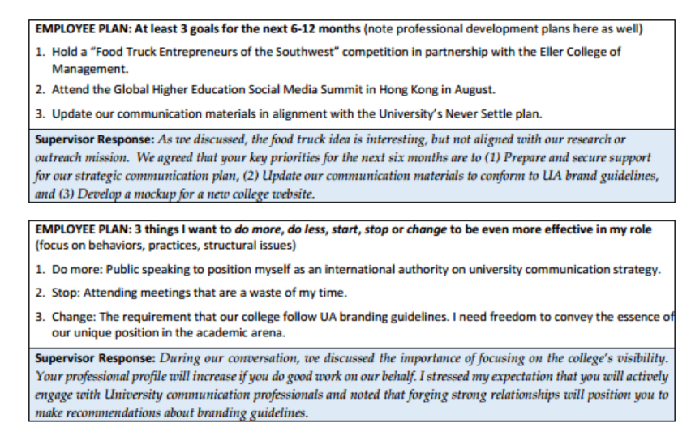

Slide 42
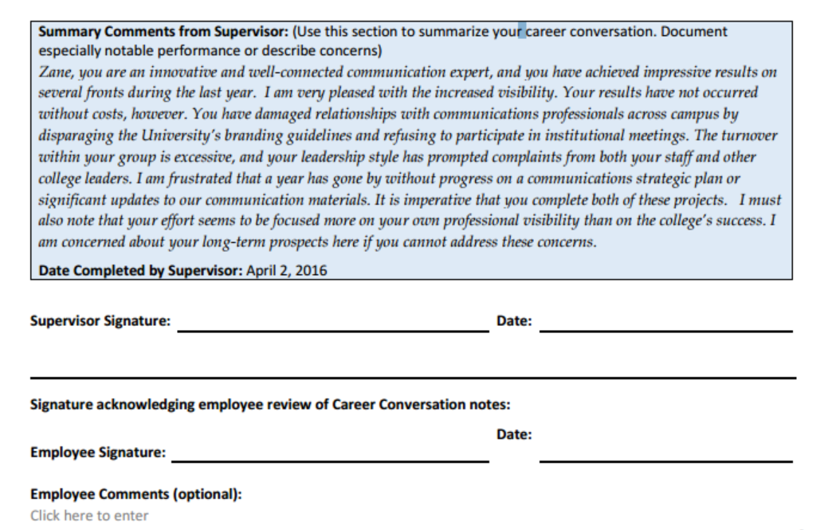

Slide 43
Some questions from your employees…
Why do we have to do our review this way?
How does this differ from what has been done in the past?
How does this affect raises and/or merit raises?

Slide 44
Q&A

Slide 45
Thank you!

