Slide 1
UAccess Employee
Recruitment
(Recruitment Proposal Offer)
UAccess Speaker Series, February 23, 2016
Nina Bates, Office of the Provost
Chris Wolf, Human Resources
Notes:
Updated 2.18.16

Slide 2

Objectives
Definition and history
Purpose
Recruitment process
Preparation
Step-by-step
Routing
Q&A

Slide 3
Definition
Manager Self Service module located within UAccess Employee
UAccess Employee > MSS Online Forms > Recruitment > Create Offer
Only used for Tenured/Tenure Eligible Faculty and Continuing/Continuing Eligible Employee
History: Part of the ADVANCE grant. The recruitment process used to include proposal and now eliminated to streamline process

Slide 4
Purpose
To keep track of faculty recruitment to tie back to the recruitment plans that the deans submitted to the Office of the Provost
A mechanism to keep track and/or confirm funding commitments from Office of the Provost, Office for Research & Discovery (ORD – formerly VPR) and/or other units
To ensure Letter of Offers are accurate and follow UHAP

Slide 5
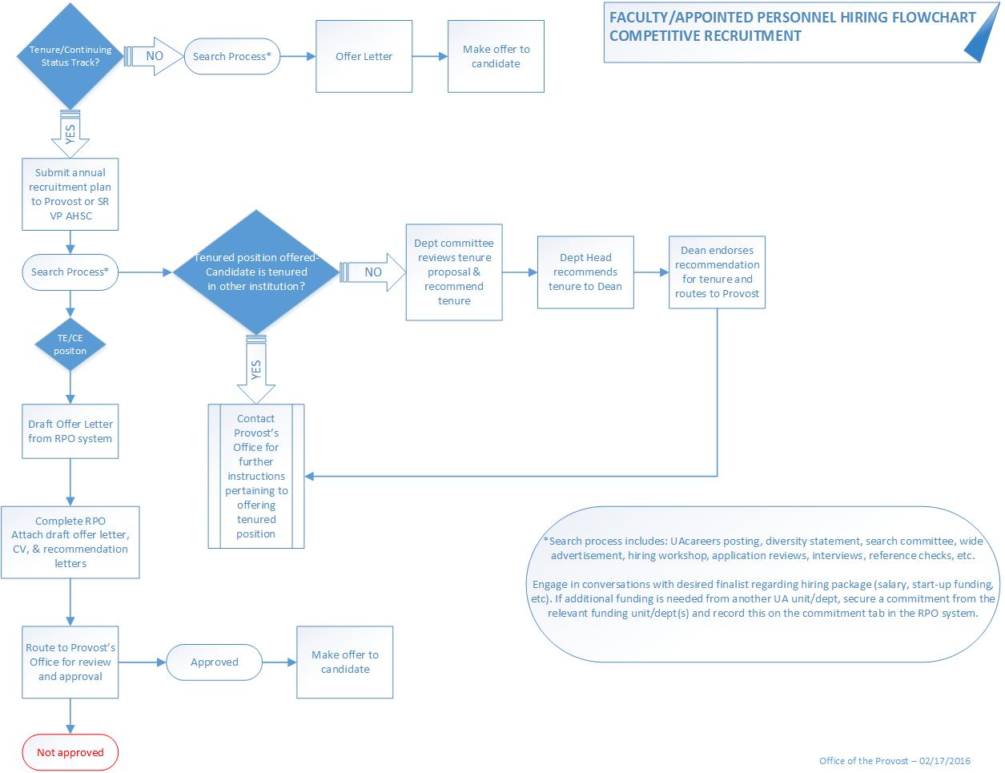
Recruitment Process

Slide 6
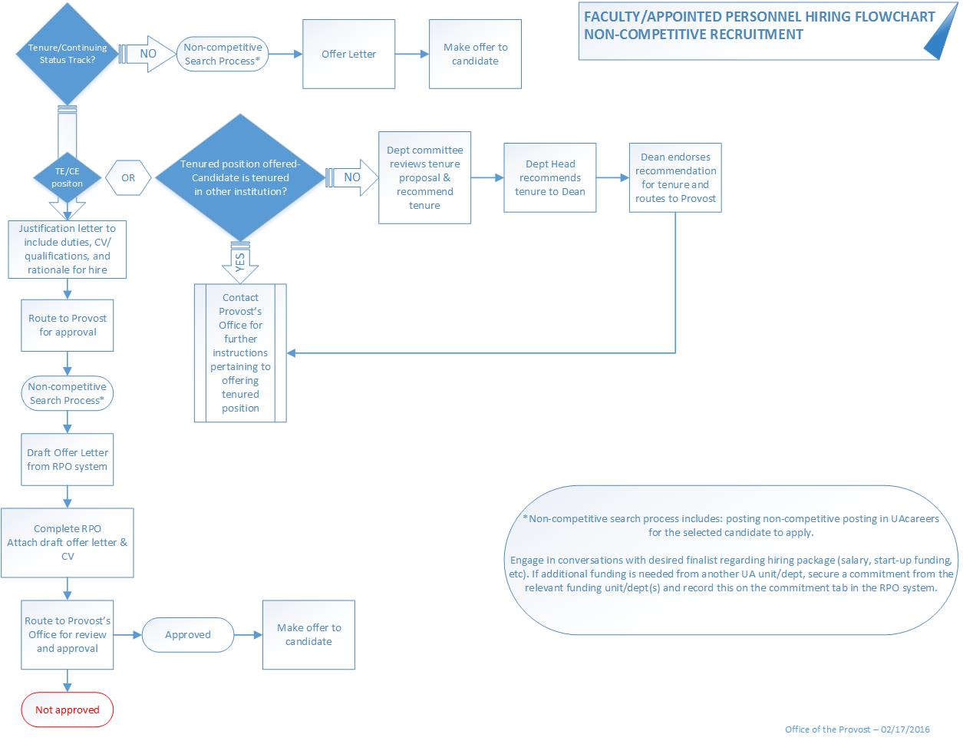
Recruitment Process

Slide 7
What to Prepare
Ensure that all parties have access especially the approvers – UAccess Provisioning Tool
Communicate with your college to get information, such as: Approved recruitment plan (if applicable); Approved non-competitive hire (if applicable); Salary; Start-up funds; Space Requirements; Technology Requirements; Moving Expense; Other personnel Requirements: partner hire, graduate assistantship, etc

Slide 8
What to Prepare (cont.)
Commitment information, i.e.
    Provost commitment
    ORD commitment
    Salary and/or start up from dept/college (home dept/college and/or other)
ID # if candidate is a current UA employee or student
Candidate personal information
PCN for the position (can be vice line or new PCN)

Slide 9
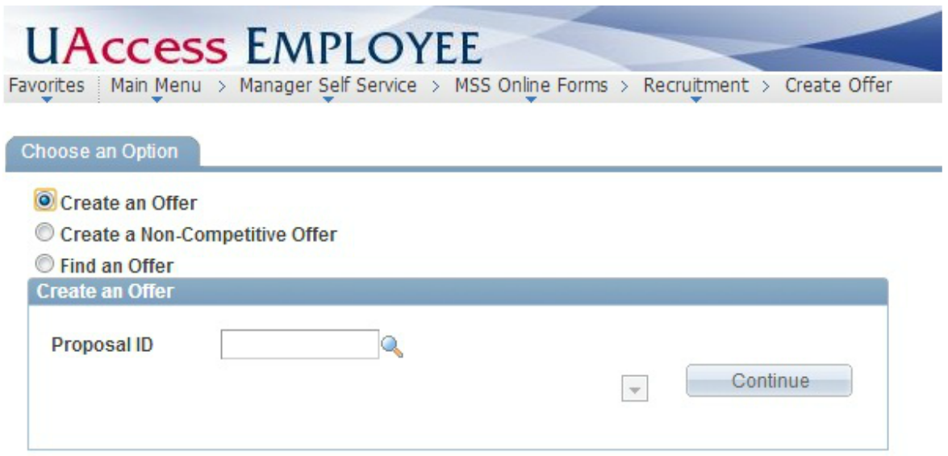
Step-by-step

Slide 10
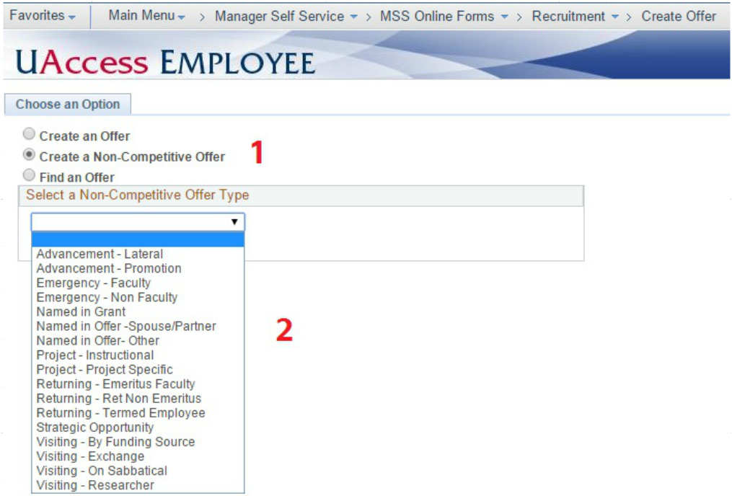

Slide 11
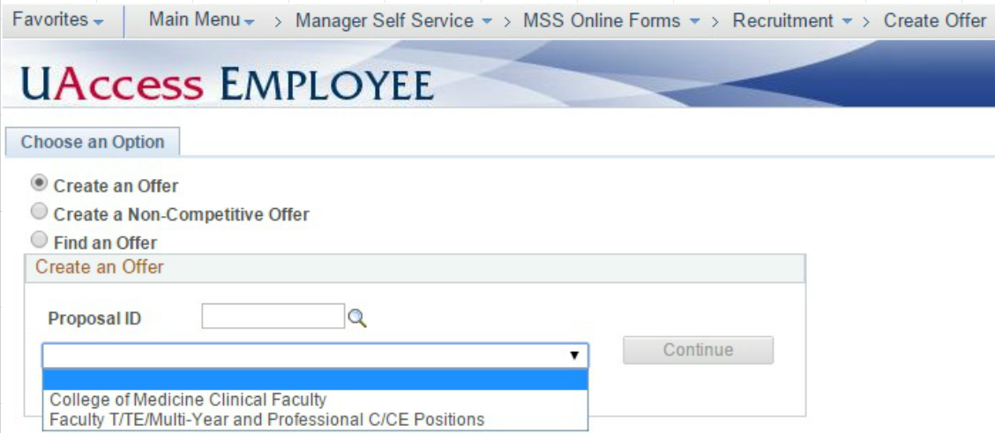

Slide 12
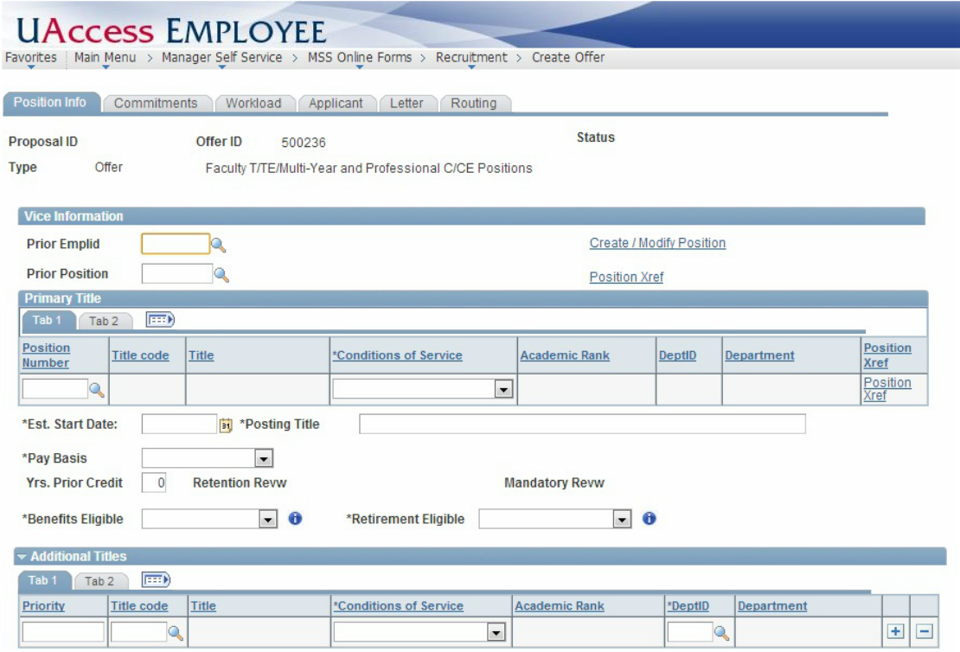

Slide 13
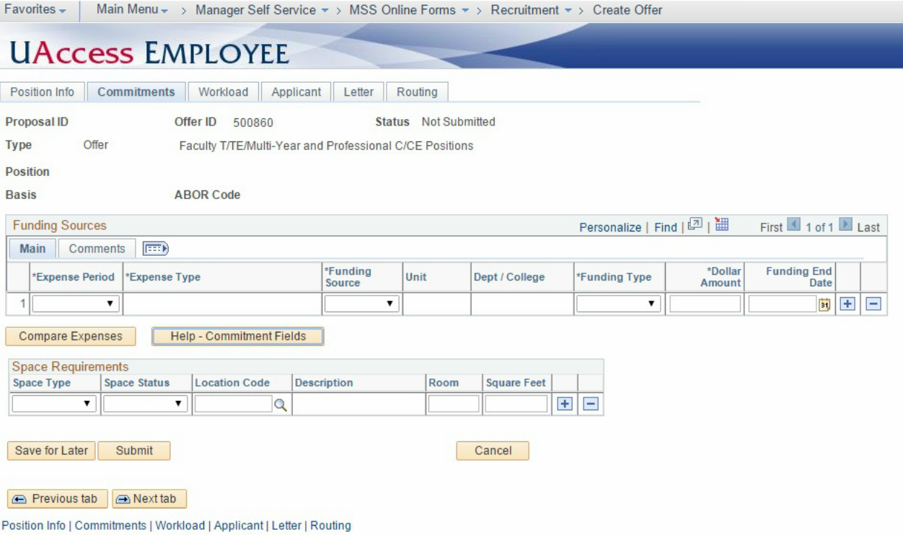

Slide 14
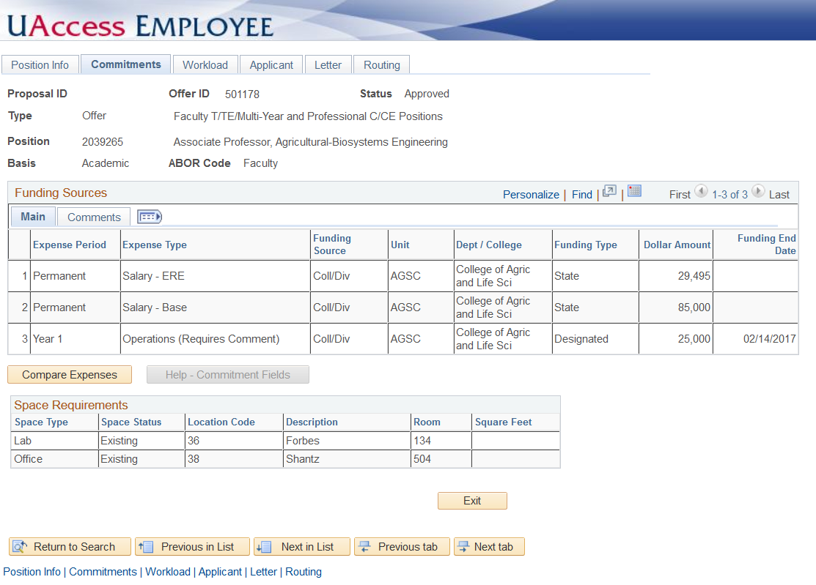

Slide 15
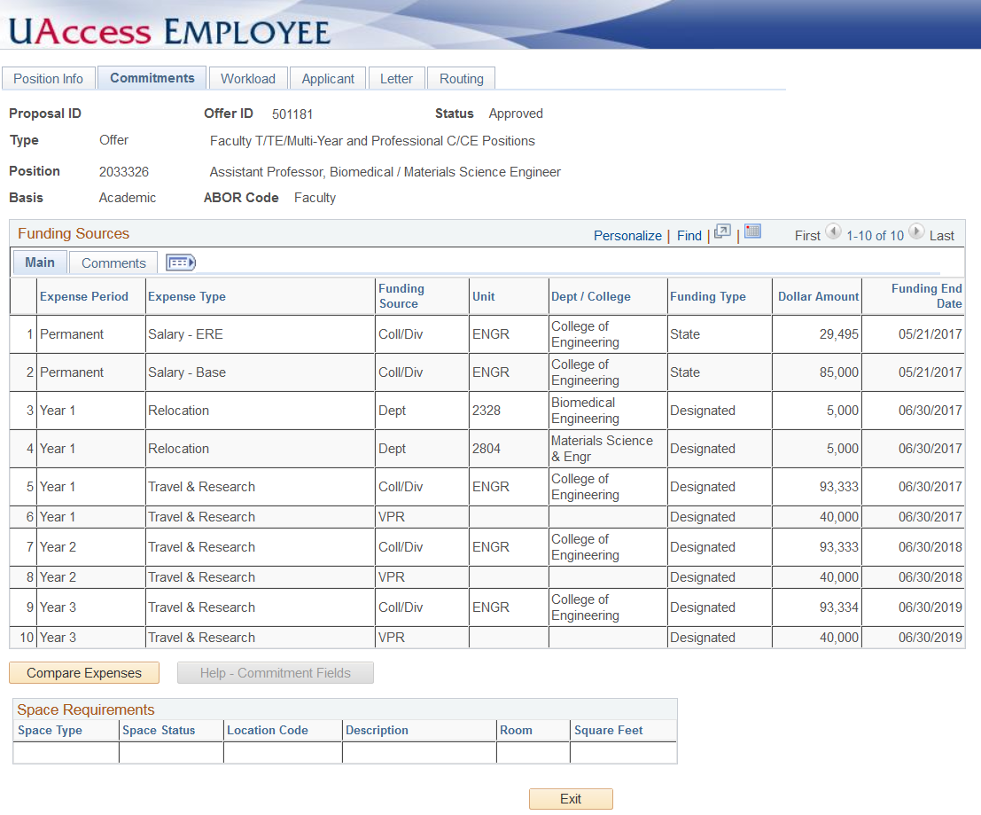

Slide 16
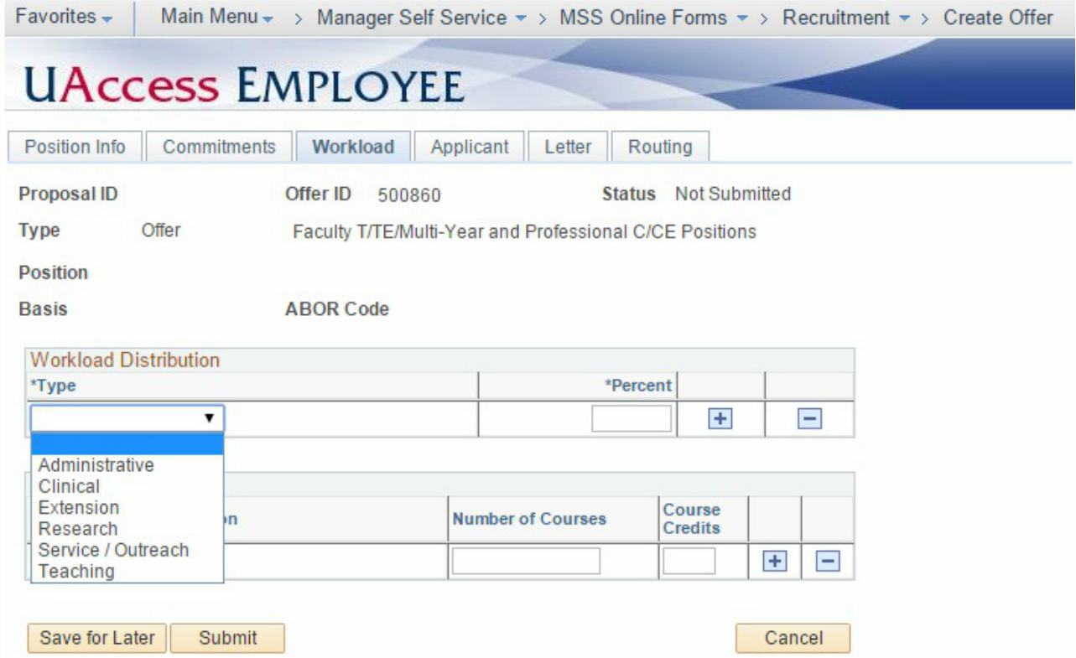

Slide 17
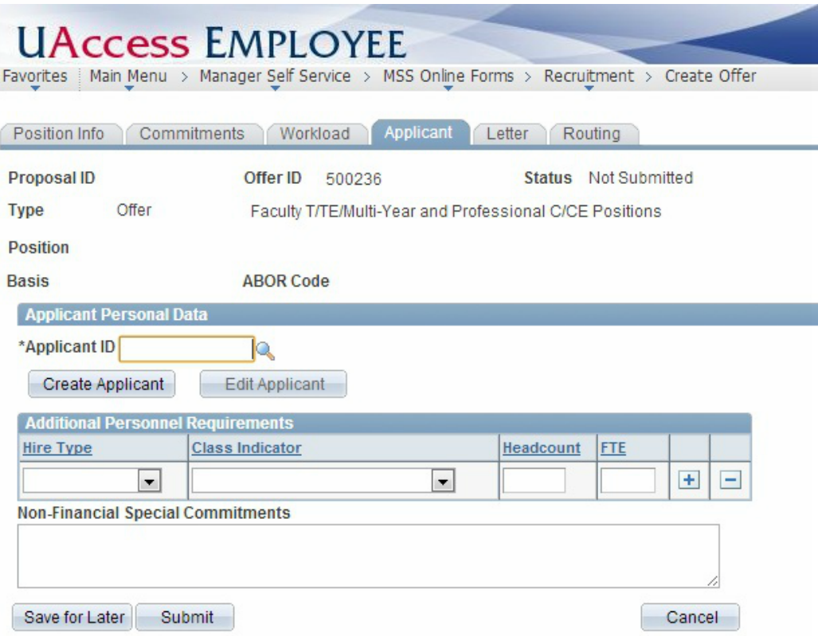

Slide 18
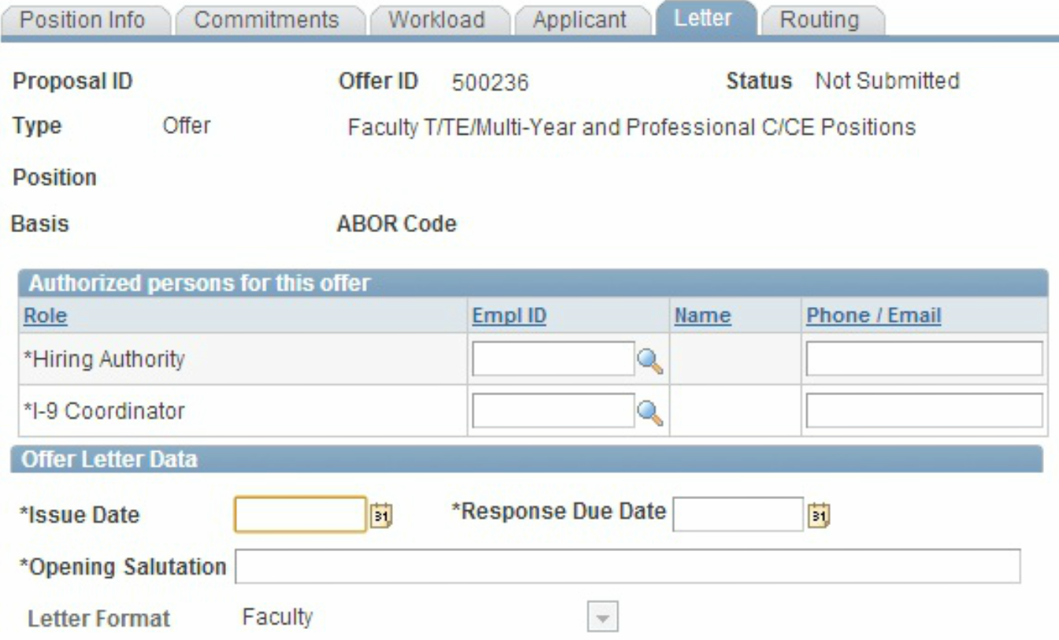

Slide 19
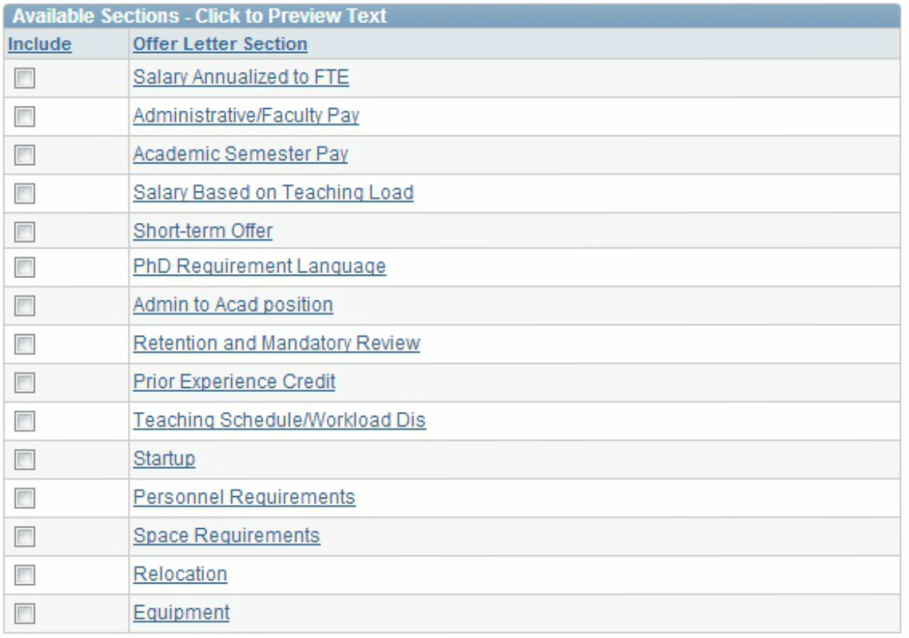
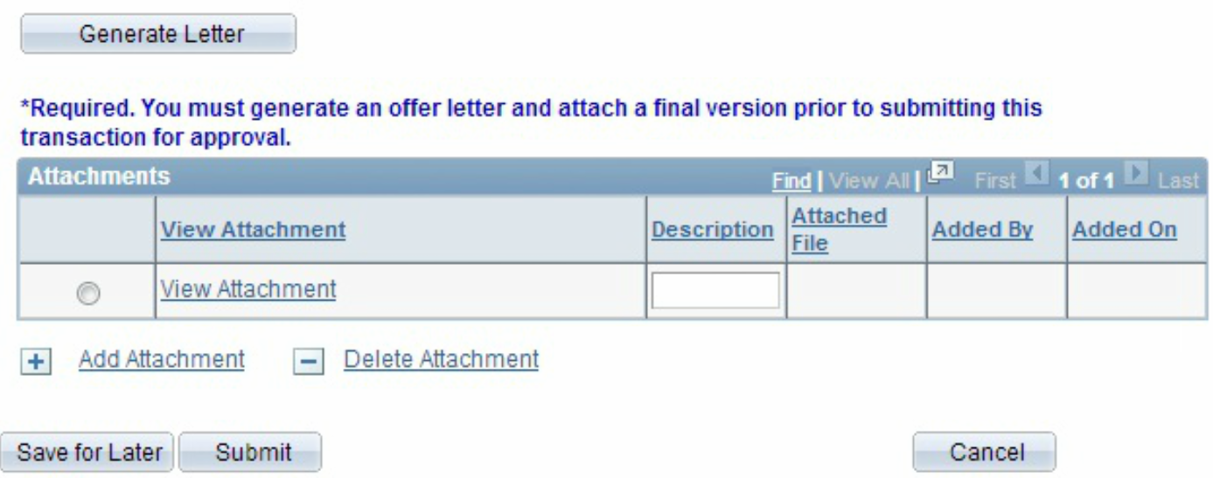

Slide 20
Attachments
Attachments required:
    A draft of the letter of offer
    Candidate’s CV
    Three (3) letters of recommendation
    Other letters/memos pertaining for tenured or continuing status

Slide 21
Routing
Approvers include dept/college/unit that are in the funding commitment
All offers will go to Office of the Provost
System doesn’t allow the transaction to be routed back. Has to be denied and resubmit

Slide 22
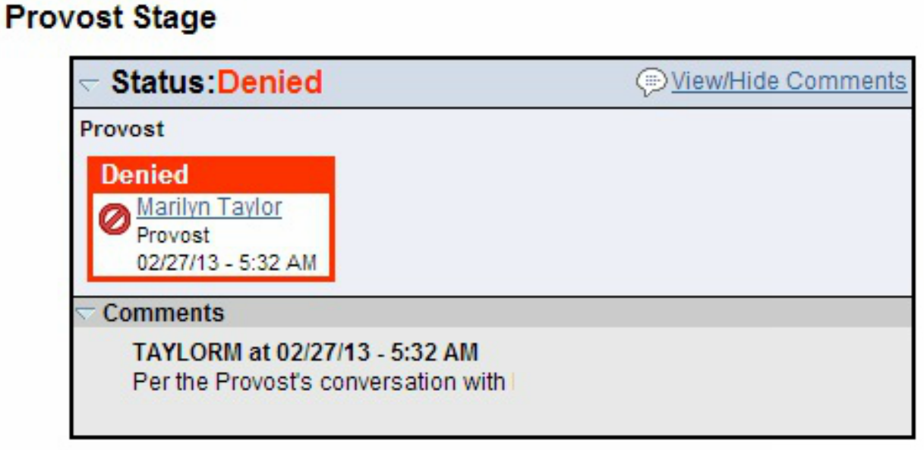

Slide 23
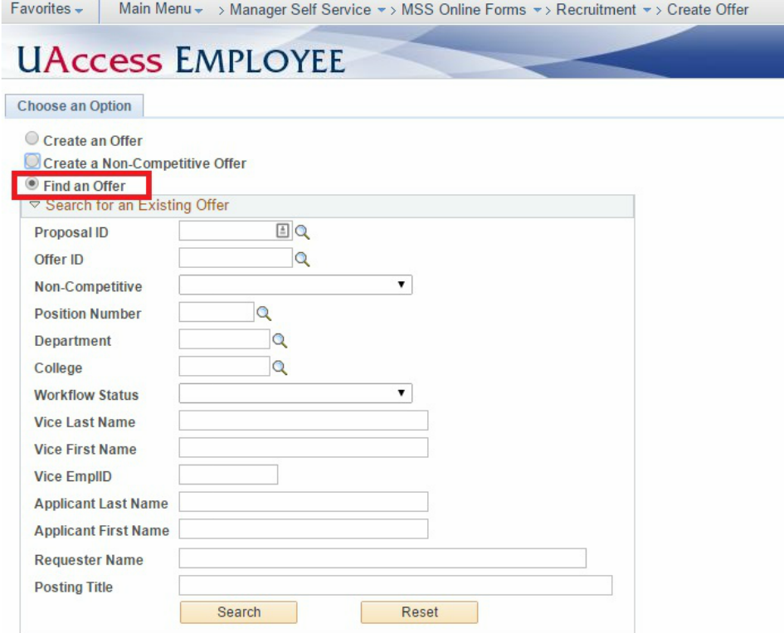

Slide 24
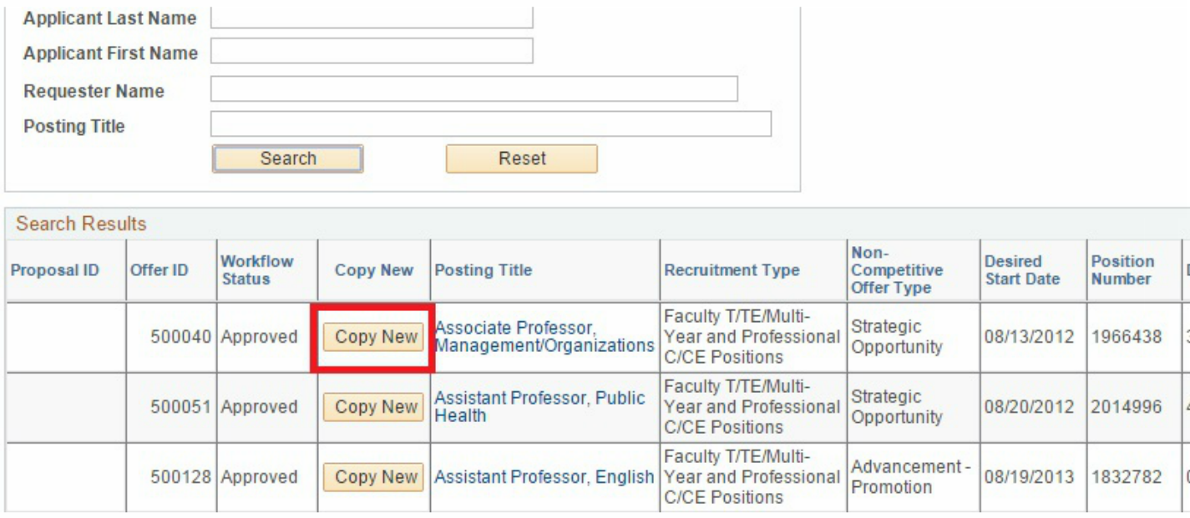

Slide 25
QUESTIONS?

