Slide 1
Welcome to TA 101

Slide 2
Welcome
Matt mars, Agricultural Education, Technology and innovation

Slide 3
Cardon Teaching Fellows
Fellows are elected members of the Bart Cardon Academy for Teaching Excellence (CATE) in the College of Agriculture and Life Sciences (CALS)
With the goal of enhancing the scholarship of teaching within the College, the Fellows:
-organize and conduct workshops
-mentor new faculty and teaching assistants
-promote and evaluate nominations for teaching awards
-coach teachers interested in student learning
-support the work of Career and Academic Services in CALS

Slide 4
Today’s Schedule
Time | Topic | Presenter
3:00pm | Welcome and Introduction | Matt Mars, PhD (Agricultural Education, Technology and Innovation)
3:05pm | Opening Activity | Shannon Warren – PhD candidate (Norton School)
3:20pm | Module 1: Professional Skills | Jennifer Ravia, MS, MA (Nutritional Sciences)
3:40pm | Module 2: Nuts and Bolts | Jennifer Ricketts, PhD (Nutritional Sciences)
4:00pm | Module 3: Interactive Discussions | Joan Curry, PhD (Environmental Science)
4:30pm | Module 4: Time Management & Work/Life Balance | Matt Mars, PhD (Agricultural Education, Technology and Innovation)
4:55pm | Closing | Matt Mars, PhD (Agricultural Education, Technology and Innovation)

Slide 5
Opening Activity
Shannon Warren, Norton School

Slide 6
Opening Activity
Think about the year ahead of you as a GTA
What are some concerns you have?
Record 2-3 of these concerns on your notecard, but DO NOT put your name on it

Slide 7
Professional Skills
Jennifer Ravia, nutritional sciences

Slide 8
What are you hoping to learn?
Think about the experiences you have had/will have as a graduate TA. Whether or not you plan to continue teaching during your career, what do you hope to learn as a result of being a TA?
Take a minute to think about this individually
Then, as a group, record your responses on the whiteboard at your table

Slide 9
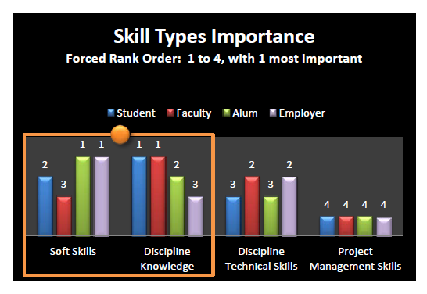
Soft (Professional) Skills vs. Academic Skills
2011 Study from Michigan State
Faculty and Students ranked discipline knowledge as most important
Employers and alumni ranked professional skills as most important
Further results can be found in the MSU report in your folder

Slide 10
Rationale for Focus on Non-Academic Skills
The National Association of Colleges and Employers (NACE) ran a survey asking hiring managers what skills they plan to prioritize when they recruit from the class of 2015 at colleges and graduate schools.
Employers also want new hires to have technical knowledge related to the job
But more important is good teamwork, decision-making and communication skills, and the ability to plan and prioritize work.
One survey showed that 72% of education leaders said students are well prepared to enter the workplace, but only 42% of employers thought so. In a similar Gallup poll, it was 96 vs. 11%!
Is this common sense? If yes, then it wouldn’t be a problem

Slide 11
Training for a profession
Take advantage of opportunities to present
Lectures
Posters
Symposiums

Slide 12
Nuts and Bolts
Jennifer Ricketts, nutritional sciences

Slide 13
Instructions re handout
Locate the handout that highlights communication, classroom caveats and grading reminders
Read through the handout individually and try to think of any challenges you have had, either as an undergrad or grad student, with regards to these topics

Slide 14
Questions:
Experienced TA’s: What have been some challenges you have faced in:
Communication with faculty and/or students?
Grading?
Using D2L?
New TA’s: What were some challenges as an undergraduate with respect to:
Communication?
Grades?
Using a Learning Management System such as D2L?

Slide 15
Interactive Discussions
Joan Curry, Environmental Science

Slide 16
Interactive Discussions
Each table will be given a scenario
Read individually and then discuss as a group
What are some effective solutions?
What would be the wrong way to handle your scenario?
Be ready to share

Slide 17
Scenario 1: You TA for a large lecture class. Your duties mostly include attending class and grading assignments. Although your contact information and office hours are listed in the syllabus, you’ve only had a couple visitors and already into week 6. Two days before the first big midterm, a student emails you and says she ‘doesn’t understand anything’. When you receive the email, you are at dinner with a few friends who are also GTAs, but for different courses. Your friend Chloe suggests that you email the student with the link to the study guide and tell them to make sure they are attending class.
Your friend Roberto suggests that you email the student and say that you need a more specific question in order to help them. Your friend Elsa suggests that you think more deeply about what is going on. The student probably hasn’t been studying like they should, and has just realized they are in trouble regarding the pending exam. Elsa suggests you first let the student know that you understand how anxious she feels. Then let her know that you’d like to meet with her so that you can come up with some strategies for this test, and also for subsequent exams. End by letting her know that you are available for questions via email in the meantime if there is something specific she is struggling with. Which friend do you think has the best advice? Why?

Slide 18
Scenario 2: You’re a GTA for a small class. Although you usually attend with the instructor, you haven’t led any classes alone yet. You know all the students’ names, though you haven’t had much individual interaction with them. The instructor will be out of town this week and has asked you to fill in for both Tuesday and Thursday lectures. You’ve spent a lot of time preparing, but aren’t confident the week will go as well as you hope. What if they ask something you don’t know? What if they think you are unqualified?
Nevertheless, you have a plan and some extra activities in case things move quicker than you anticipate. When you show up on Tuesday, one of the students, Dominic, seems really irritated and appears to be giving you dirty looks during class. You start to think that Dominic knows that you are unsure of your abilities. Maybe he studied the material and you said something wrong. You double down on your efforts to prepare and show up Thursday feeling hopeful. However, Dominic is absent, even though there is a graded quiz scheduled for the end of class that day. What should you do?

Slide 19
Scenario 3: Wayne has a pretty good relationship with the students in the class he TA’s for. They seem to like him, and he often helps them with tough questions on their homework. Students occasionally come to office hours, but most interactions are via email or in the few minutes after the instructor lectures. A couple weeks before the end of the semester, Wayne is at Bison Witches to have dinner and a beer with a friend. He sees a few of his students when he gets there and gives them a quick wave and smile before sitting down.
When getting ready to leave, Wayne’s friend leaves to use the restroom. One of the students approaches Wayne and asks if he and his friend want to join them for another beer. These particular students are good students, seems interested in the material, and are fun to be around. Wayne wants to join them, but has reservations. He starts to say ‘thank you, but no’ – and the students say ‘come on Wayne!’ He agrees and sits down just as his friend is returning. His friend whispers that this is not a good idea. What do you think?

Slide 20
Scenario 4: Ben is incoming graduate student in a department that requires all new students to TA. He is nervous, though, because he is generally pretty quiet and shy. He joined the program because he wants to do bench research and has no interest in teaching. Nevertheless, he has decided to try his best. He is assigned to a Friday discussion section and will lead class each week. The first day wasn’t terrible, but classroom management was definitely an issue. The students seemed to know that he was nervous. They talked with their neighbors and texted during class, rarely paying attention. At one point, a student shouted ‘speak up’ and then she and her friends laughed. Ben got the feeling they were making fun of his nervousness.
The next week, Ben came prepared. He let the class know that there were expectations for a courteous classroom, and that they would lose points for distracting behavior or not participating. Most of the students settled down and seemed fine with the guidelines. The student from last week though, the one who shouted, seemed to become emboldened. She consistently talked to her friends at inappropriate times and rudely questioned Ben about his qualifications as well as the course content. By the end of the fourth week, he has had enough. The student is affecting class, and every time she has an outburst he loses is train of thought. What can he do moving forward?

Slide 21
Scenario 5: Janelle is a TA for a large lecture class. She occasionally helps with lecture, but most of her student interaction is via office hours and grading. One day, when grading a long written assignment, Janelle comes across a student assignment that has been 85% plagiarized from a student who previously took the course. Per the agreement with the instructor, Janelle gave the student a zero and left feedback in d2L asking the student to contact the instructor.
Two days later, the student shows up in Janelle’s office distressed. She breaks down crying and explains that she knew it was wrong to use her friend’s assignment, but there had been a death in the family and she just didn’t know how to manage all of her schoolwork while dealing with family issues and maintaining her job on campus. She asks Janelle for another chance. Janelle hasn’t said anything to the instructor yet, but has a meeting with her to discuss class later that afternoon. What should Janelle say to the student? What should Janelle do about the plagiarized assignment? What should Janelle say to the instructor?

Slide 22
Time Management and Work/Life Balance
Matt mars, Agricultural Education, Technology and innovation

Slide 23
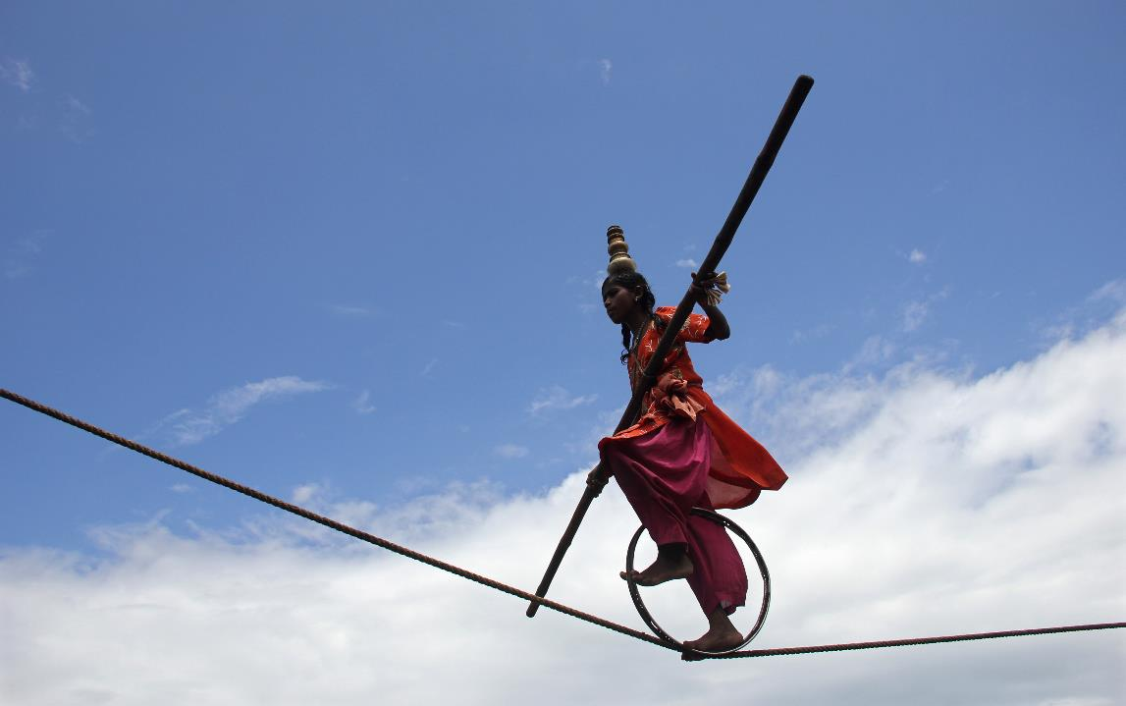
Time management and balance

Slide 24
Time management and balance
Research
TA duties
Life
Coursework

Slide 25
Time management and balance
TA duties
Coursework
Research
Life

Slide 26
Time management and balance
It might not always seem like it….
TA duties
Coursework
Research
Life

Slide 27
Time management and balance
It might not always seem like it….
TA duties
Coursework
Research
But your advisor, your professor, your students, your friends, your family, and you are all on the same page
Life

Slide 28
Time management and balance
It might not always seem like it….
TA duties
Coursework
Research
But your advisor, your professor, your students, your friends, your family, and you are all on the same page
A balanced
Life

Slide 29
Time management and balance
It might not always seem like it….
TA duties
Coursework
Research
But your advisor, your professor, your students, your friends, your family, and you are all on the same page
A balanced
Life

Slide 30
Time management and balance: let’s discuss “real life”
TA duties
Coursework
Research
A balanced
Life

Slide 31
Time management and balance: let’s discuss “real life”
• Think about your use of time in ‘real life.’
How do you spend your time?
What’s important to you ‘at the end of the day’?
• Reflect: to what degree do you set your own schedule?
Do you have a flexible or rigid structure to your days?
What can you change, and what has to stay the same?
• Consider: how important is time management to you?
Do you feel better and more effective with a plan in mind?
Why or why not?
• Identify: how do you manage your ‘real life’ time?
Do you use the same approach as you did in, say,
high school? Why or why not?
TA duties
Coursework
Research
A balanced
Life

Slide 32
Time management and balance: let’s discuss “real life”
• Think about your use of time in ‘real life.’
How do you spend your time?
What’s important to you ‘at the end of the day’?
• Reflect: to what degree do you set your own schedule?
Do you have a flexible or rigid structure to your days?
What can you change, and what has to stay the same?
• Consider: how important is time management to you?
Do you feel better and more effective with a plan in mind?
Why or why not?
• Identify: how do you manage your ‘real life’ time?
Do you use the same approach as you did in, say,
high school? Why or why not?
TA duties
Coursework
Research
A balanced
Life

Slide 33
Time management and balance: let’s discuss “real life”
• Think about your use of time in ‘real life.’
How do you spend your time?
What’s important to you ‘at the end of the day’?
• Reflect: to what degree do you set your own schedule?
Do you have a flexible or rigid structure to your days?
What can you change, and what has to stay the same?
• Consider: how important is time management to you?
Do you feel better and more effective with a plan in mind?
Why or why not?
• Identify: how do you manage your ‘real life’ time?
Do you use the same approach as you did in, say,
high school? Why or why not?
TA duties
Coursework
Research
A balanced
Life

Slide 34
Time management and balance: let’s discuss “real life”
• Think about your use of time in ‘real life.’
How do you spend your time?
What’s important to you ‘at the end of the day’?
• Reflect: to what degree do you set your own schedule?
Do you have a flexible or rigid structure to your days?
What can you change, and what has to stay the same?
• Consider: how important is time management to you?
Do you feel better and more effective with a plan in mind?
Why or why not?
• Identify: how do you manage your ‘real life’ time?
Do you use the same approach as you did in, say,
high school? Why or why not?
TA duties
Coursework
Research
A balanced
Life

Slide 35
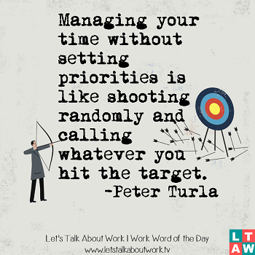
Time management and balance: let’s discuss “real life”
TA duties
Coursework
Research
A balanced
Life
→ How do we identify our priorities?

Slide 36
Time management and balance: let’s discuss “real life”
URGENCY
A
B
Important, but
not urgent
Urgent and
important
TA duties
Coursework
IMPORTANCE
D
C
Research
Neither urgent
nor important
Urgent, but
unimportant
A balanced
Life
→ How do we identify our priorities?

Slide 37
Time management and balance: let’s discuss “real life”
URGENCY
Where do the following fall for you?
Posting class items to D2L
Spending time with family/friends
Enjoying healthy recreation
Preparing for a committee meeting
Getting ready to meet your advisor
Developing new teaching
Grading exams
Writing your thesis
Posting on social media
Game of Thrones
What’s not on this list?
A
B
Important, but
not urgent
Urgent and
important
IMPORTANCE
D
C
Neither urgent
nor important
Urgent, but
unimportant
→ How do we identify our priorities?

Slide 38
Time management and balance: let’s discuss “real life”
URGENCY
Where do the following fall for you?
Posting class items to D2L
Spending time with family/friends
Enjoying healthy recreation
Preparing for a committee meeting
Getting ready to meet your advisor
Developing new teaching
Grading exams
Writing your thesis
Posting on social media
Game of Thrones
What’s not on this list?
A
B
Important, but
not urgent
Urgent and
important
IMPORTANCE
D
C
Neither urgent
nor important
Urgent, but
unimportant
→ How do we identify our priorities?... And how do we reach our goals?

Slide 39
Time management and balance: let’s discuss “real life”
URGENCY
Where do the following fall for you?
Posting class items to D2L
Spending time with family/friends
Enjoying healthy recreation
Preparing for a committee meeting
Getting ready to meet your advisor
Developing new teaching
Grading exams
Writing your thesis
Posting on social media
Game of Thrones
What’s not on this list?
Attend to these
B
Important, but
not urgent
Urgent and
important
IMPORTANCE
D
C
Neither urgent
nor important
Urgent, but
unimportant
→ How do we identify our priorities?... And how do we reach our goals?

Slide 40
Time management and balance: let’s discuss “real life”
URGENCY
Where do the following fall for you?
Posting class items to D2L
Spending time with family/friends
Enjoying healthy recreation
Preparing for a committee meeting
Getting ready to meet your advisor
Developing new teaching
Grading exams
Writing your thesis
Posting on social media
Game of Thrones
What’s not on this list?
Attend to these
Be sure to do these
Important, but
not urgent
Urgent and
important
IMPORTANCE
D
C
Neither urgent
nor important
Urgent, but
unimportant
→ How do we identify our priorities?... And how do we reach our goals?

Slide 41
Time management and balance: let’s discuss “real life”
URGENCY
Where do the following fall for you?
Posting class items to D2L
Spending time with family/friends
Enjoying healthy recreation
Preparing for a committee meeting
Getting ready to meet your advisor
Developing new teaching
Grading exams
Writing your thesis
Posting on social media
Game of Thrones
What’s not on this list?
Attend to these
Be sure to do these
Important, but
not urgent
Urgent and
important
IMPORTANCE
D
Consider, but balance
Neither urgent
nor important
Urgent, but
unimportant
→ How do we identify our priorities?... And how do we reach our goals?

Slide 42
Time management and balance: let’s discuss “real life”
URGENCY
Where do the following fall for you?
Posting class items to D2L
Spending time with family/friends
Enjoying healthy recreation
Preparing for a committee meeting
Getting ready to meet your advisor
Developing new teaching
Grading exams
Writing your thesis
Posting on social media
Game of Thrones
What’s not on this list?
Attend to these
Be sure to do these
Important, but
not urgent
Urgent and
important
IMPORTANCE
Do not do ☺
Consider, but balance
Neither urgent
nor important
Urgent, but
unimportant
→ How do we identify our priorities?... And how do we reach our goals?

Slide 43
Time management and balance: let’s discuss “real life”
URGENCY
Where do the following fall for you?
Posting class items to D2L
Spending time with family/friends
Enjoying healthy recreation
Preparing for a committee meeting
Getting ready to meet your advisor
Developing new teaching
Grading exams
Writing your thesis
Posting on social media
Game of Thrones
What’s not on this list?
Attend to these
Be sure to do these
Important, but
not urgent
Urgent and
important
IMPORTANCE
Neither urgent
nor important
Urgent, but
unimportant
→ How do we identify our priorities?... And how do we reach our goals?

Slide 44
Time management and balance: being a TA is part of “real life”
URGENCY
Where do the following fall for you?
Posting class items to D2L
Spending time with family/friends
Enjoying healthy recreation
Preparing for a committee meeting
Getting ready to meet your advisor
Developing new teaching
Grading exams
Writing your thesis
Posting on social media
Game of Thrones
What’s not on this list?
Attend to these
Be sure to do these
Important, but
not urgent
Urgent and
important
IMPORTANCE
Neither urgent
nor important
Urgent, but
unimportant
→ How do we identify our priorities?... And how do we reach our goals?

Slide 45
Time management and balance: being a TA is part of “real life”
Experienced TAs:
what has worked for you?
what would you do differently?
what will you do differently this time?
New TAs:
what are your concerns?
what are your experiences so far?
how is your balance working?
what can you change to succeed?
TA duties
Coursework
Research
A balanced
Life
Life

Slide 46
Time management and balance: being a TA is part of “real life”
A strategic and thoughtful process…
• Aim for structure, balance, and clarity
• Set realistic goals for each day and week, and meet them
• Recognize this shift in your training / commitments
• Communicate with faculty (course) and mentor (advisor)
Understand your TA commitment (time)
Clarify your role and expectations (effort, style)
Approach faculty early to avoid panic/limit stress
Make ‘work time’ = work time; have ‘guilt-free time’
Take care of yourself (personally, professionally)
Ask for help when you need it (peers, mentor, friends)
Work on your ‘personal schedule’ when you can
Explore ‘opportunity’ vs. ‘chore’ mentality
TA duties
Coursework
Research
A balanced
Life

Slide 47
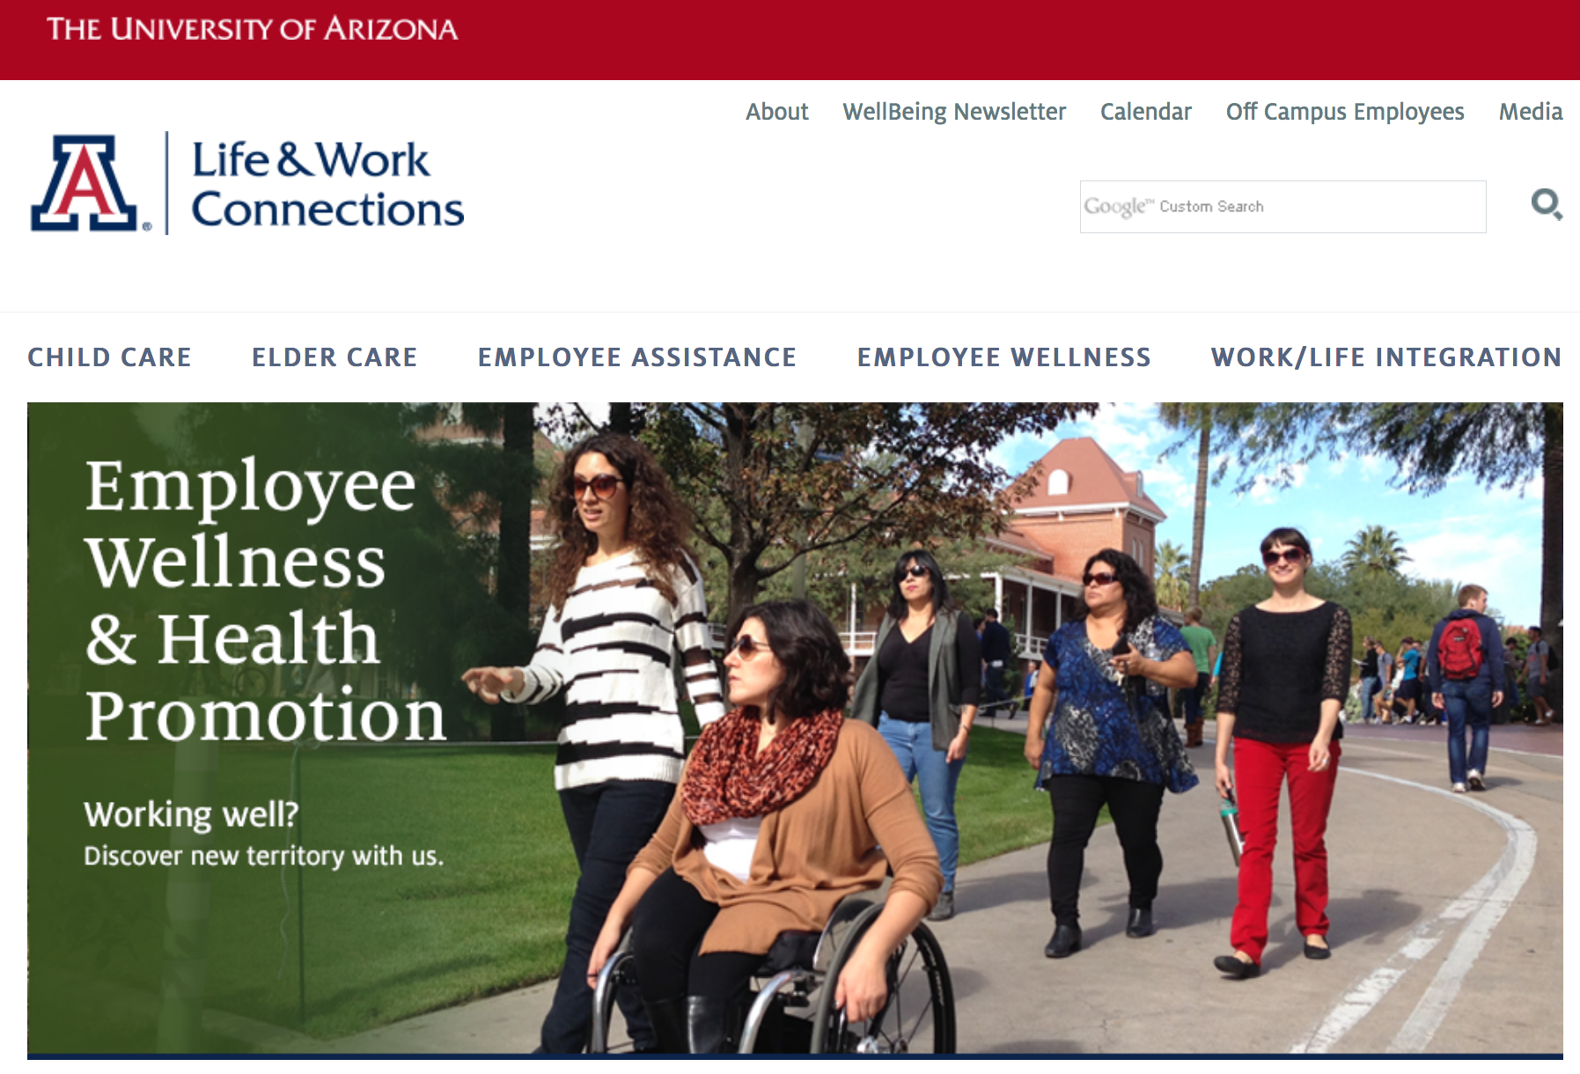
UA has great resources for work/life balance and support
TA duties
Coursework
Research
A balanced
Life
https://lifework.arizona.edu/
Life

Slide 48
UA has great resources for work/life balance and support
TA duties
Coursework
Research
A balanced
Life
Life
https://www.health.arizona.edu/

Slide 49
Closing
Matt mars, Agricultural Education, Technology and innovation

